Slide 1

Docker Foundation
An in depth introduction to Docker and Containers

Slide 2
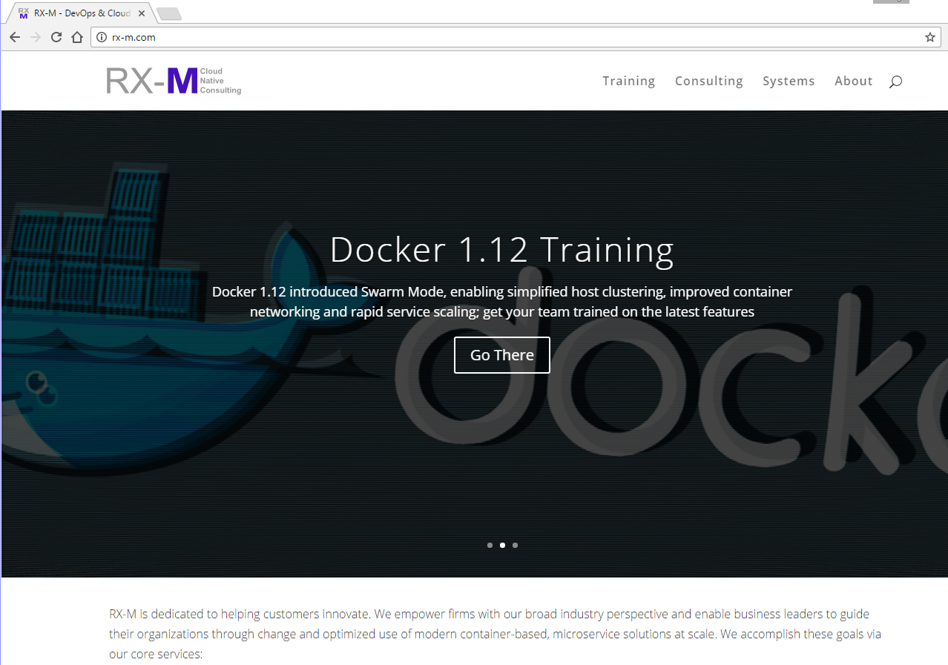
RX-M Cloud Native Training
Microservice Oriented
Microservices Foundation [2 Day]
Building Microservices with Go [3 Day]
Container Packaged
Docker Foundation [3 Day]
Docker Advanced [2 Day]
Rocket [2 Day]
Dynamically Managed
Docker Orchestration (Compose/Swarm) [2 Day]
Kubernetes Foundation [2 Day]
Kubernetes Advanced [2 Day]
Mesos Foundation [2 Day]
MANTL [2 Day]
Nomad [2 Day]

Slide 3
Docker & Containers
Copyright 2013-2016, RX-M LLC
Container Overview
Container Basics
Controlling Containers
Advanced Container Operations

Slide 4
1: Container Overview

Slide 5
Objectives
Understand the basic nature of containers
Explain the container value proposition
Examine the differences and similarities between Virtual Machines (VMs) and Containers
Consider the roles of IaaS, PaaS, and Containers
Explain the purpose and positioning of Docker in the container space
Define the Docker system requirements
Learn how to install Docker

Slide 6


What is Docker?
Docker is an open-source project that automates the deployment of applications inside software containers
Originally released in March of 2013
Apache 2.0 license
Source on GitHub
Containers provide “operating-system virtualization” on Linux
Containers utilize: OS Virtualization
Containers avoid the overhead of starting virtual machines
VMs utilize: Machine Virtualization
Docker uses resource isolation features of the Linux kernel such as cgroups and kernel namespaces to allow many diverse containers to run within a single Linux instance
Docker, Inc. is a venture backed company composed of the original authors and current maintainers of the Docker software

Slide 7
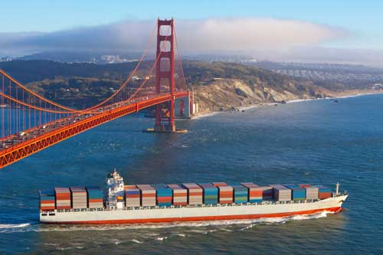
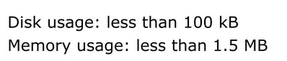
What is a container?
Lightweight Linux environment
Now lightweight Windows environments as well
Encapsulated and deployable
Runnable
A way to package applications for reliable deployment
Particularly popular for packaging microservices
Made widely popular by Docker
Docker simplifies configuring, constructing and running containers
Docker Inc. provides a container platform including systems for publishing and sharing containers
Container technology predates and enables Docker
Docker was the dominant mover in this space during 2013-2015
Competition is maturing
Standards exist and are evolving
Ex. OCI, appc
$ time docker run ubuntu echo "hello world"
hello world
real 0m0.319s
user 0m0.005s
sys 0m0.013s

Slide 8
Largest container fallacy
Containers replace virtual machines
Virtual Machines aren’t going anywhere and are the basis for cloud infrastructure globally
Containers can replace VMs in circumstances where:
VMs were being used due to lack of alternatives for application packaging
VMs were being used for process isolation wherein the constituent processes all run on Linux in a single tenant environment
If the only tool you have is a hammer, everything looks like a nail.
-- Abraham Maslow

Slide 9
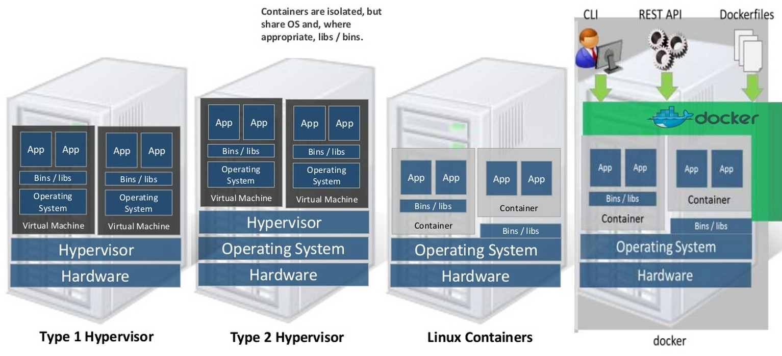
VMs and Containers
VM
A virtual machine for operating systems
Container
A virtual operating system for applications
These are not mutually exclusive and many environments become optimal when properly combining both
Containers supply only the executables and library interfaces necessary to mimic the application dependent aspects of a Linux distribution (Ubuntu, RHEL, SUSE, etc.), leveraging the fact that all Linux systems use the same underlying kernel
Source: IBM

Slide 10
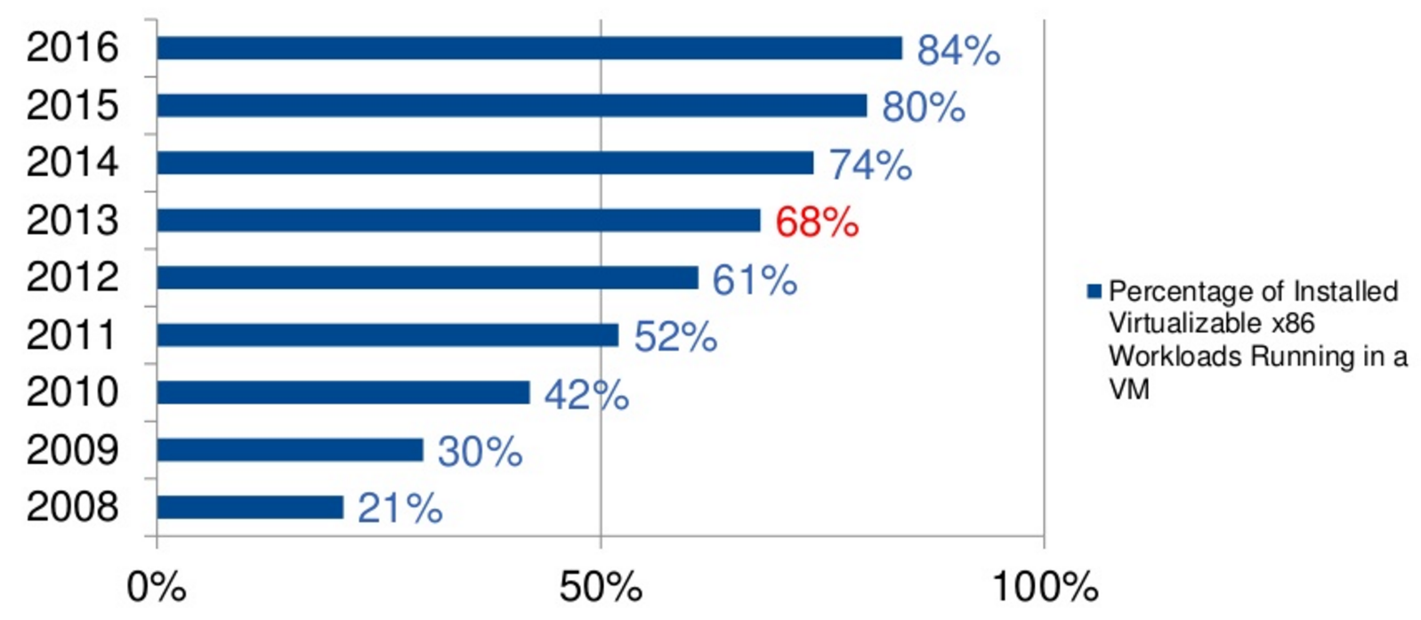
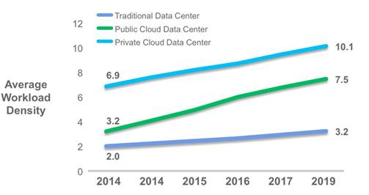
VMs, why do I care?
VM’s allow new machine instances to be deployed in real time (seconds-minutes)
Not months, as is typical with physical server purchase/deploy cycles
VM’s enable migration and elasticity
Machines can be created, moved and deleted rapidly
VM’s allow physical resources to be fully utilized
Physical CPU/RAM use can be maximized without mixing logical machine roles
Increased server density
VM’s enable repeatable static system environments to be used for development, testing and deployment
The same machine can be launched by Vagrant, OpenStack, Amazon EC2, Microsoft Azure, Google Cloud, etc.
VM’s enable cloud computing
Pay as you go
Self service
IaaS
2013 Gartner Group study

Slide 11
The killer feature of Docker:
Reliable deployment
Containers include their own dependencies, isolated from the underlying operating system and other containers

Slide 12
Containers, why do I care?
Containers provide a static application runtime environment creating reliable deployments
Fundamentally changes the approach to operations
Removes an entire class of extremely complex operational problems
VMs are typically used to host infrastructure roles (e.g. Web Server, Application Server, Database Server, …)
Applications running on such systems can have complex interactions with system services and other applications
This complexity makes it difficult to guarantee identical dev/test/prod environments, making application deployment complex and error prone
Containers create a new layer of abstraction at the operating system level for application roles (web server, logging system, security tools, monitoring software, etc.)
Isolation
Allows multiple containerized applications to run on the same VM
Encapsulation
Each container is encapsulated with its own unique dependencies
Portability
Repeatable deployment across dev/test/prod environments and clouds
App A
App B
Lib.1
Kernel
VM
Container
Container
App A
App B
Lib.1
Lib.2
PaaS
Kernel
VM

Slide 13
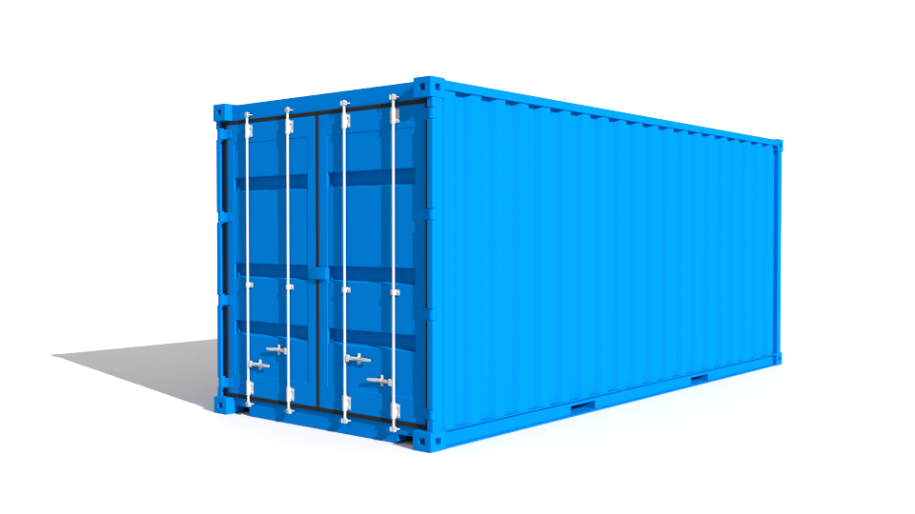
Encapsulation
Containers can encapsulate:
Data
Code
Configuration files
Frameworks
Libraries
System Dependencies
Packaging
Linux Distributions
Environment Variables
Everything needed by an application can be packaged within the application’s container
We can ignore where and how the container runs
The container’s internals do not interact with external aspects of the environment, removing an entire class of deployment problems

Slide 14
The second killer feature of Docker:
Efficiency
Time to Launch
Server Density
Performance
Containers can be launched and shutdown at the speed of a process and can directly use/share system resources; typically 1/10th to 1/100th the size of the equivalent application packaged within a VM, increasing server density; containers offer the opportunity for isolation with the performance of bare metal

Slide 15
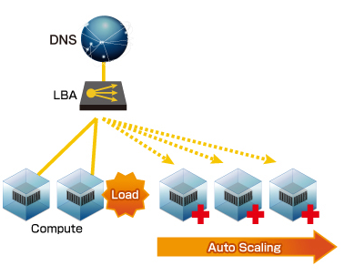
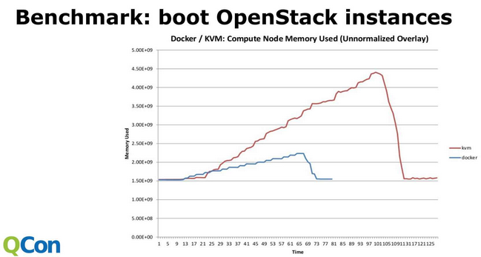
Scaling Events & Restart
Containers can be started and stopped in milliseconds
Timing like running a program, because it is running a program
Run container (dependencies built in)
VMs are started and stopped in seconds/minutes
Timing like booting a computer because it is booting a computer
Bootloader
OS start
Service start
CM run (puppet/chef/ansible/salt etc.)
Downloading packages
Application start
Container based applications can be scaled in/out quickly
But you must have a cluster to scale them on!
Failed services within a container can be restarted quickly
KVM
Time/Memory to start/stop 15 Apache Web Servers
Docker

Slide 16
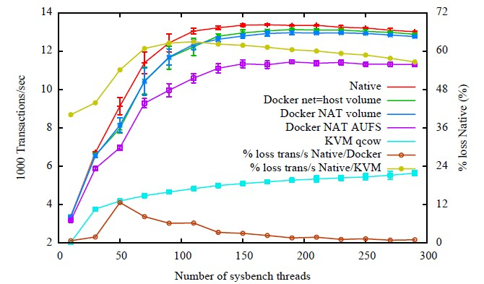
Inter Service Communications
Inter VM
Strong isolation enforced by hypervisor and hardware
Forces inter VM process communications to use networking interfaces (Ethernet/IP/[UDP|TCP])
Some hypervisors have fast paths but these are often platform specific and some require hardware support
The Strength of VMs: Very secure
Inter Container
Tunable isolation (namespaces can be isolated or shared)
Can communicate over IP loopback (localhost/127.0.0.1)
No name lookup
No NIC translation
Directories can be shared (therefore supporting named pipes, UNIX sockets, memory mapped files)
Shared memory
Shared kernel structures (semaphores, mutexes, message queues, etc.)
The Strength of Containers: Very fast
MySQL Benchmark
Source: IBM
KVM is not NUMA aware

Slide 17
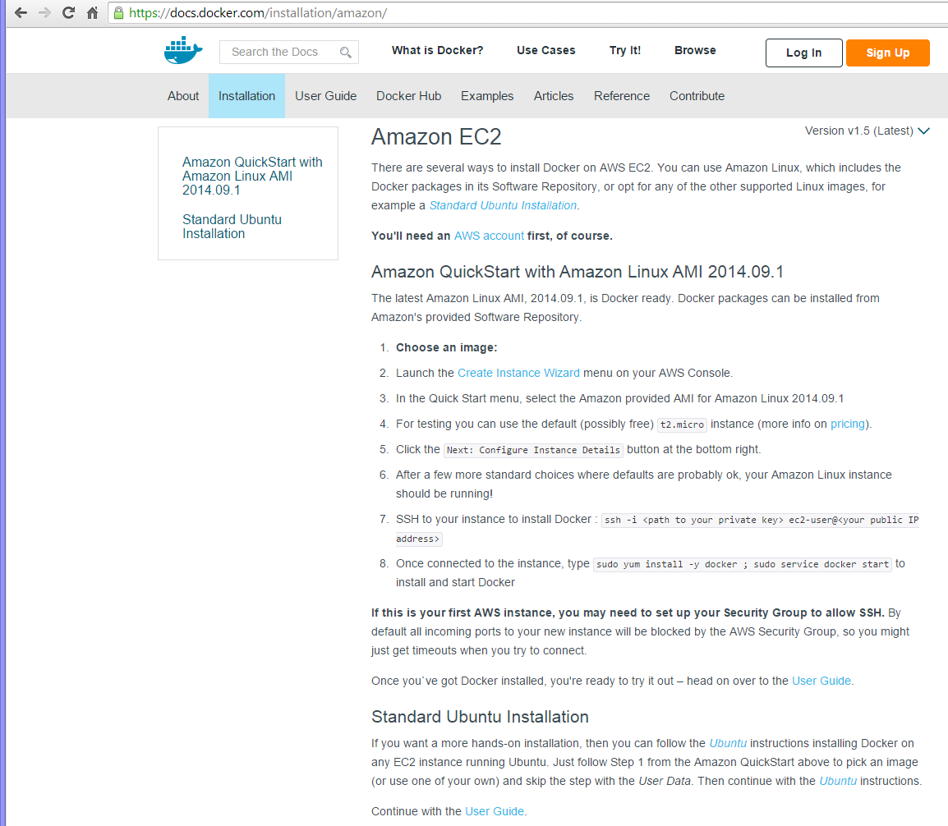
Docker Installation
Docker is easy to install on a range of platforms and cloud systems:
OSes with predefined Docker packages
Debian/Ubuntu
Red Hat EL/CentOS/Oracle EL/Fedora
Gentoo
Arch Linux
FrugalWare
OpenSUSE/SUSE EL
CRUX Linux
Desktop/Laptop Installers
Mac OS X
Microsoft Windows
Cloud Instances
Google Cloud Platform
Rackspace Cloud
Amazon EC2
DigitalOcean
IBM Softlayer
Many others
Others (e.g. CoreOS) provide their own direct support
Binaries are also supplied for custom installations
RHEL/Centos and Ubuntu are the recommended/most tested platforms
http://futurist.se/gldt

Slide 18
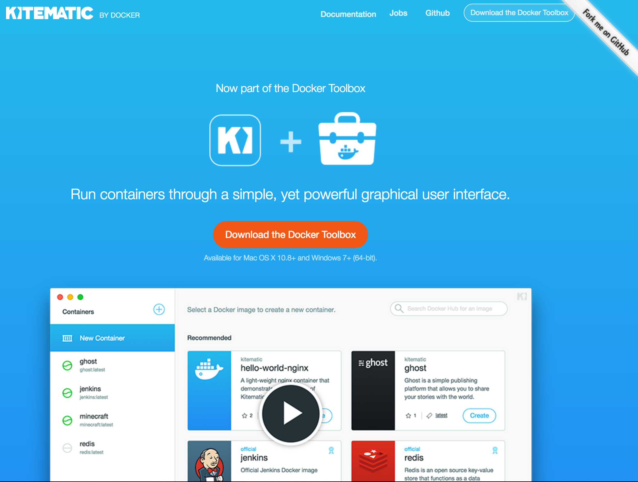
Docker on the Desktop
Docker for Mac/Windows (7/2016)
Mac HyperKit (uses xhyve)
OS X 10.10.3 Yosemite or newer
https://github.com/docker/HyperKit/
https://github.com/mist64/xhyve
Windows Hyper V
64bit Windows 10 Pro, Enterprise or Education with HyperV enabled
https://technet.microsoft.com/library/hh831531.aspx
Docker Engine runs in an Alpine Linux VM
Installs the Docker CLI, Compose and Machine natively
These are new and problems have been reported associated with HyperV and HyperKit interfering with VirtualBox and VMware
Docker Toolbox (circa 2015)
You can still use Docker Toolbox if xhyve or HyperV are not available or problematic
Uses the VirtualBox hypervisor
Includes Kitematic, Docker Machine, Docker Swarm, and Docker Compose
Docker Machine manages the Docker VM
Machine still uses the Boot2Docker Linux image to run containers
Boot2Docker (circa 2014)
The original Docker desktop solution
Used VirtualBox and the boot2docker launcher
KITEMATIC
A Docker GUI for Mac/Windows

Slide 19
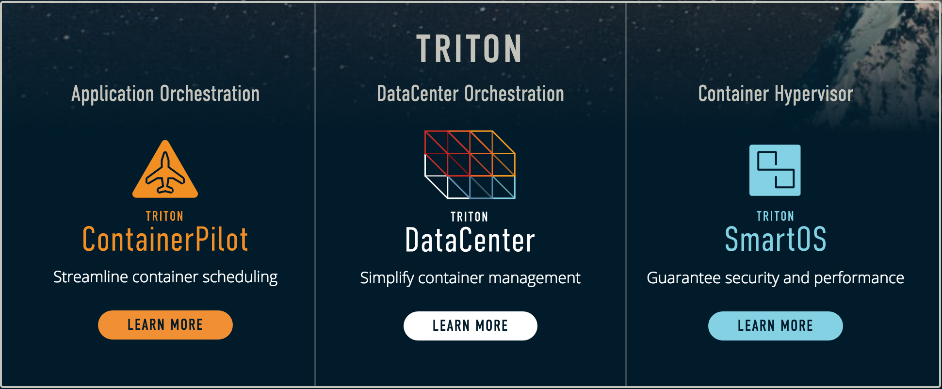

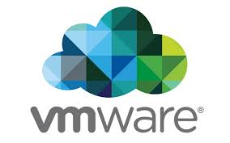


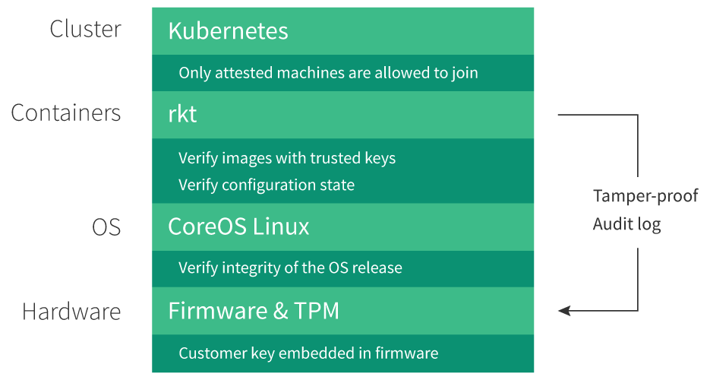
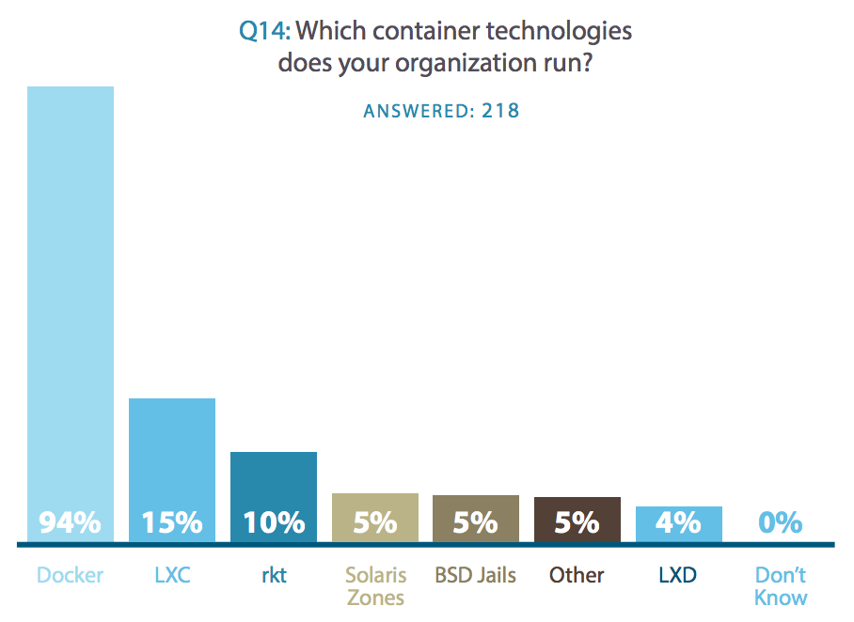

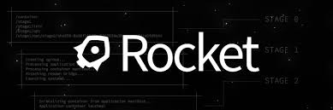
Docker Alternatives
Virtual Machines
Better isolation, slower performance and more complex deployment
VMware, Amazon Web Services, Google, and Rackspace all run Docker-based workloads on behalf of cloud customers in a multi-tenant environment, but do so by putting each customer's Docker containers inside the logical boundaries of virtual machines
CoreOS Inc. Tectonic
CoreOS is a minimal Linux OS with direct support for containers (including docker)
Similar to RHEL Atomic, Ubuntu Core and Windows 2016 Nano
Rocket (rkt) is a simple and lightweight docker like container platform
Jetpack is a FreeBSD implementation of the Rocket App Container spec
Tectonic
CoreOS/Rocket/Kubernetes integration
Google led a $12mm CoreOS investment round 4/2015
Joyent SmartOS & Triton
Triton uses the docker client but supplies SmartOS (an OpenSolaris/KVM hypervisor) with Solaris Zone isolation (using Illumos Zones) for containers offering strong security
Containers see all SmartOS/Triton machines as a single Docker host, simplifying deployment
Built by Joyent the company behind Node.js
Mesos
Distributed OS running ”frameworks”
LXC
Original Linux container library (v2.0.3 – 6/2016)
LXD/OpenVZ
Systems in containers (lightvisors)
BSD Jails
Isolation features of BSD Unix
OpenSolaris Container
Zones based isolation model
https://clusterhq.com/assets/pdfs/state-of-container-usage-june-2016.pdf

Slide 20
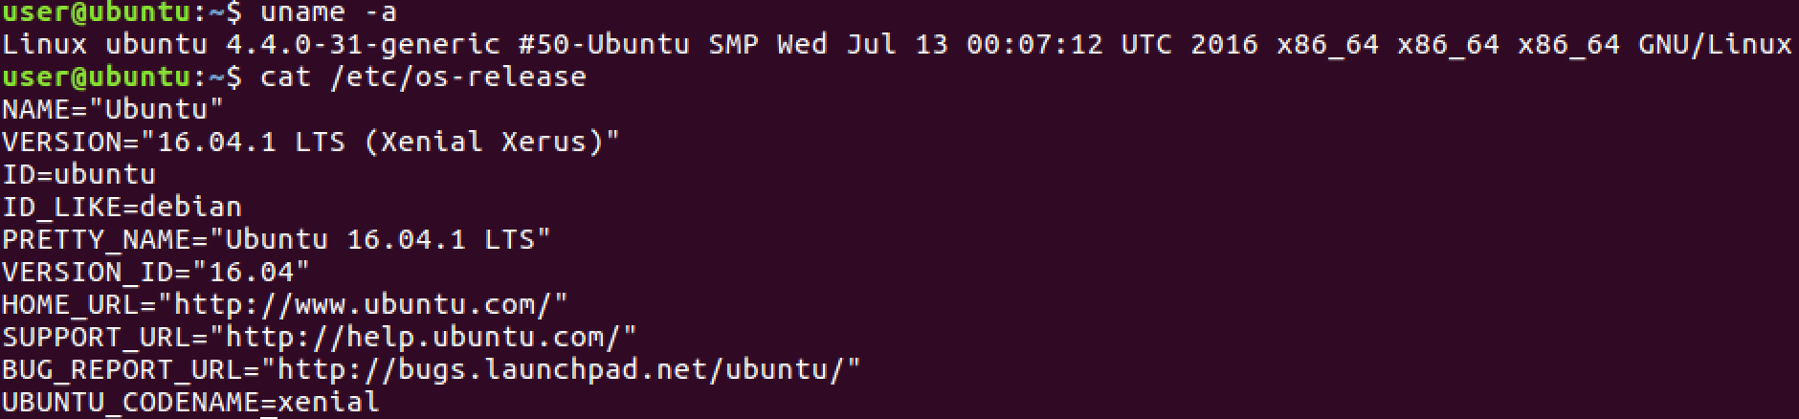
Docker Dependencies
The Docker daemon requires Linux kernel 3.10+
Kernels older than 3.10 have bugs which can cause data loss and panic under certain conditions
The latest minor version (3.x.y) of the 3.10 or newer Linux kernel is recommended
Keeping kernels up to date will ensure critical kernel bugs get fixed
Key Distros:
RHEL/Centos 7: Kernel 3.10+
Ubuntu 14.04: Kernel 3.13+, 16.04: Kernel 4.4+
Warning:
Custom kernels and kernel packages are not usually supported by Linux distribution vendors
Installing a newer kernel may fail with distributions which provide packages which are too old or incompatible with newer kernels
Docker Inc. supports x86_64 systems and added partial ARM support in v1.10
The Docker goal is to run everywhere, some vendors support Docker on other platforms
FreeBSD offers a 64 bit Linux compatibility layer supporting Docker
Free BSD info: https://wiki.freebsd.org/Docker
The Docker Engine API is supported on Joyent SmartOS by Triton, and Windows Server 2016 will ship with a Docker Engine compatible API and primitives to support container-based process isolation and resource management on Windows
Only Windows binaries based on Windows images can run on Windows
Windows info: https://msdn.microsoft.com/en-us/virtualization/windowscontainers/quick_start/manage_docker
The Docker client can run on virtually any *nix system
The client also builds on OS X and Windows

Slide 21
Summary
Virtual machines enabled the cloud era: IaaS
Providing an abstraction layer between OS and the underlying hardware
Self service compute
Pay for use
Full hardware utilization
Hardware supported isolation
Proprietary containers enabled PaaS systems
Providing an abstraction layer between applications and the OS
Did not provide users with a means to package dependencies
Standards based containers are enabling Cloud Native Applications
Providing an abstraction layer between applications and the kernel
Containers can be deployed to PaaS, IaaS/VMs and Bare Metal OSes
Containers package applications into repeatable predictable environments, easily deployed consistently in development, test and production settings
Containers enable multiple deterministic application environments to run on a single kernel instance
Docker can run on many platforms
Typically runs on x64 Linux and requires a 3.10 or later kernel

Slide 22
VMs
Lab 1
Setting up Docker
This course includes a preconfigured Ubuntu 16.04 VM for lab work
All passwords are “user”
All non root user accounts are “user”
You can also complete the labs on any base installation of Ubuntu 16.04 that you have sudo/root permissions on

Slide 23
2: Container Basics

Slide 24
Objectives
Describe the relationship between Containers and Microservices
Explain the basic Docker architecture
Docker engine
Docker Remote API
Docker client
Registries
Images
Containers
Examine Container isolation features (mount, network, UTS, process, IPC)
Try creating, listing, and removing containers
Explore docker commands for starting and controlling containers

Slide 25
Microservices and Containers
Microservices
Used to build distributed software systems with processes that communicate with each other over network interfaces in order to perform the tasks required of an application
Based on technology-agnostic interface protocols (like REST and Apache Thrift)
A more concrete and modern interpretation of SOA Service Oriented Architectures
The first realization of SOA post the introduction of DevOps
Becoming the standard for building continuously deployed systems
In contrast to SOA
Microservices answer the question of how big a service should be and how it should communicate
In a microservices architecture, services should be small with one crisp responsibility
Interface protocols should be lightweight and language agnostic
Atomically deployable, dependencies are discovered
Benefits
Enhanced cohesion and reduced coupling
Easier to change and add features
Allows the architecture of an individual service to emerge through continuous refactoring, reducing the need for a big design up-front and allows for releasing the software early and often
Docker containers work particularly well with microservices characterized as:
Short-lived
Immutable
Disposable
Service-oriented
Other applications can also benefit from containerization but microservices are the prime target

Slide 26
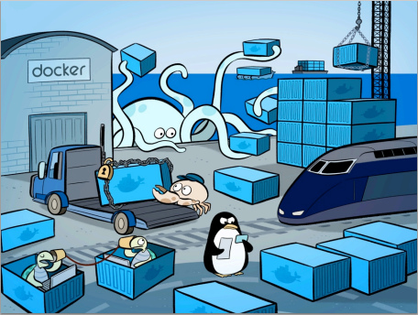
The Shipping Container Analogy
Like a normal shipping container, Docker containers are:
Interchangeable
Stackable
Portable
Generic
Making it easy to build a range of applications for deployment anywhere
CI Test Platform
Cloud Deployment
Local execution
Partner distribution
Software as a Service
Image: SD Times

Slide 27
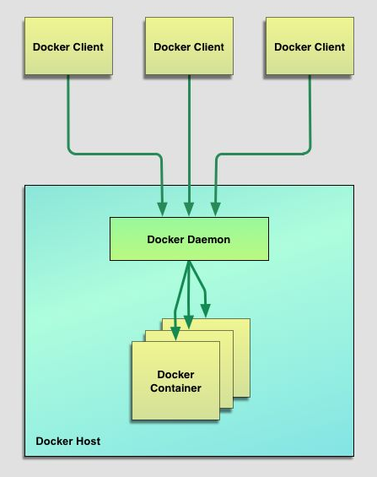
Core Docker Components
Docker Engine
Daemon on the Linux host supporting docker container execution: /usr/bin/dockerd
Docker manages containers, the linux kernel runs containers
Docker Client
The Docker client sends requests to local and remote Docker daemons: /usr/bin/docker (or docker.exe)
Docker Remote API
The Docker client talks to the Docker daemon through the Docker Remote RESTful API
Docker Images
Images are used to generate containers
Just as a VM image can create multiple VM instances
Just as an executable (/usr/bin/vi) can create multiple processes
Registries
Registries are network services from which Docker Images can be saved and retrieved
The Docker Hub is an internet based registry with support for public and private images
Private registry servers can be created for an organization’s internal use
Docker Containers
A container is a software package generated from an image
Said to be running when processes are executing within it
Can be stopped and started
Docker Remote REST API

Slide 28
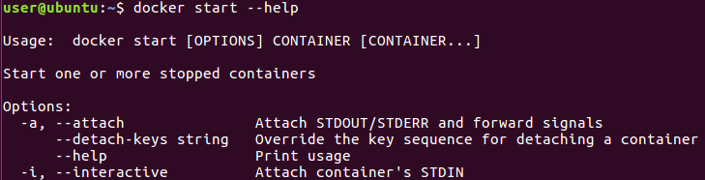
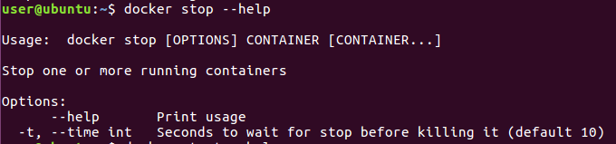
Container Lifecycle Control
Docker Containers provide support for typical service and VM control operations
ps List containers (why not ls (!?) … too late now …)
create Create a new container
rm Removes (deletes) a container from the system
start Start a container running
stop Stop a running container
restart Restart a running container or start a stopped container
run Run a new container (create + start)
pause Pause all processes within a container
unpause Unpause a paused container

Slide 29
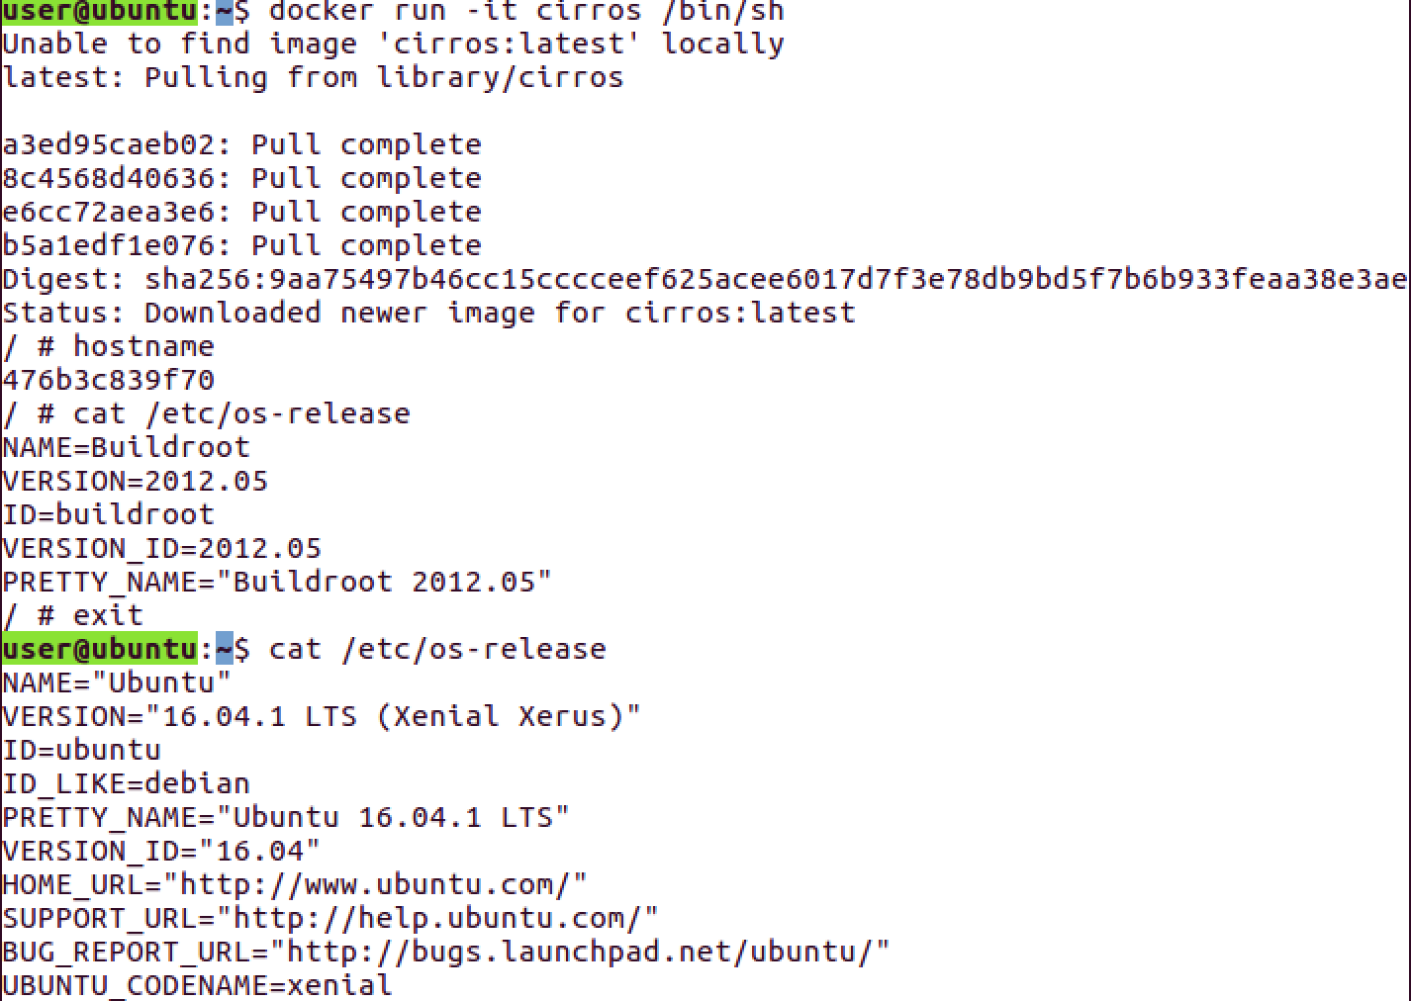
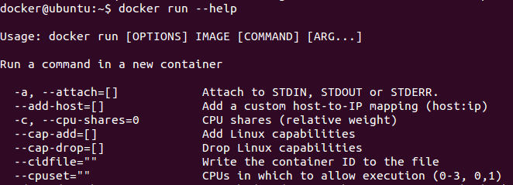
Running Containers
The docker command line client provides general command help in response to the --help switch
Specific command help can be acquired by issuing the docker sub command followed by the --help swtich
e.g. $ sudo docker run --help
The run command accepts an image and a command to run in the generated container
If no command is specified the default image command is run
Run creates a new container from the image to run the command within
The -i switch connects to the container’s STDIN stream
The -t switch creates an interactive tty within the container
Docker uses the specified image to create a new container with an isolated filesystem, IPC, process environment, and network namespace

Slide 30
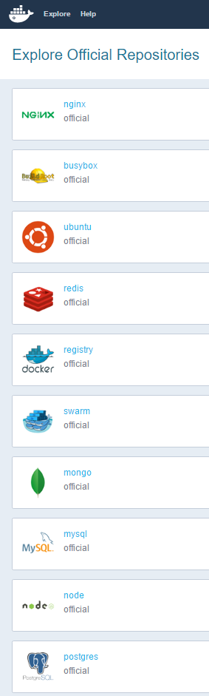
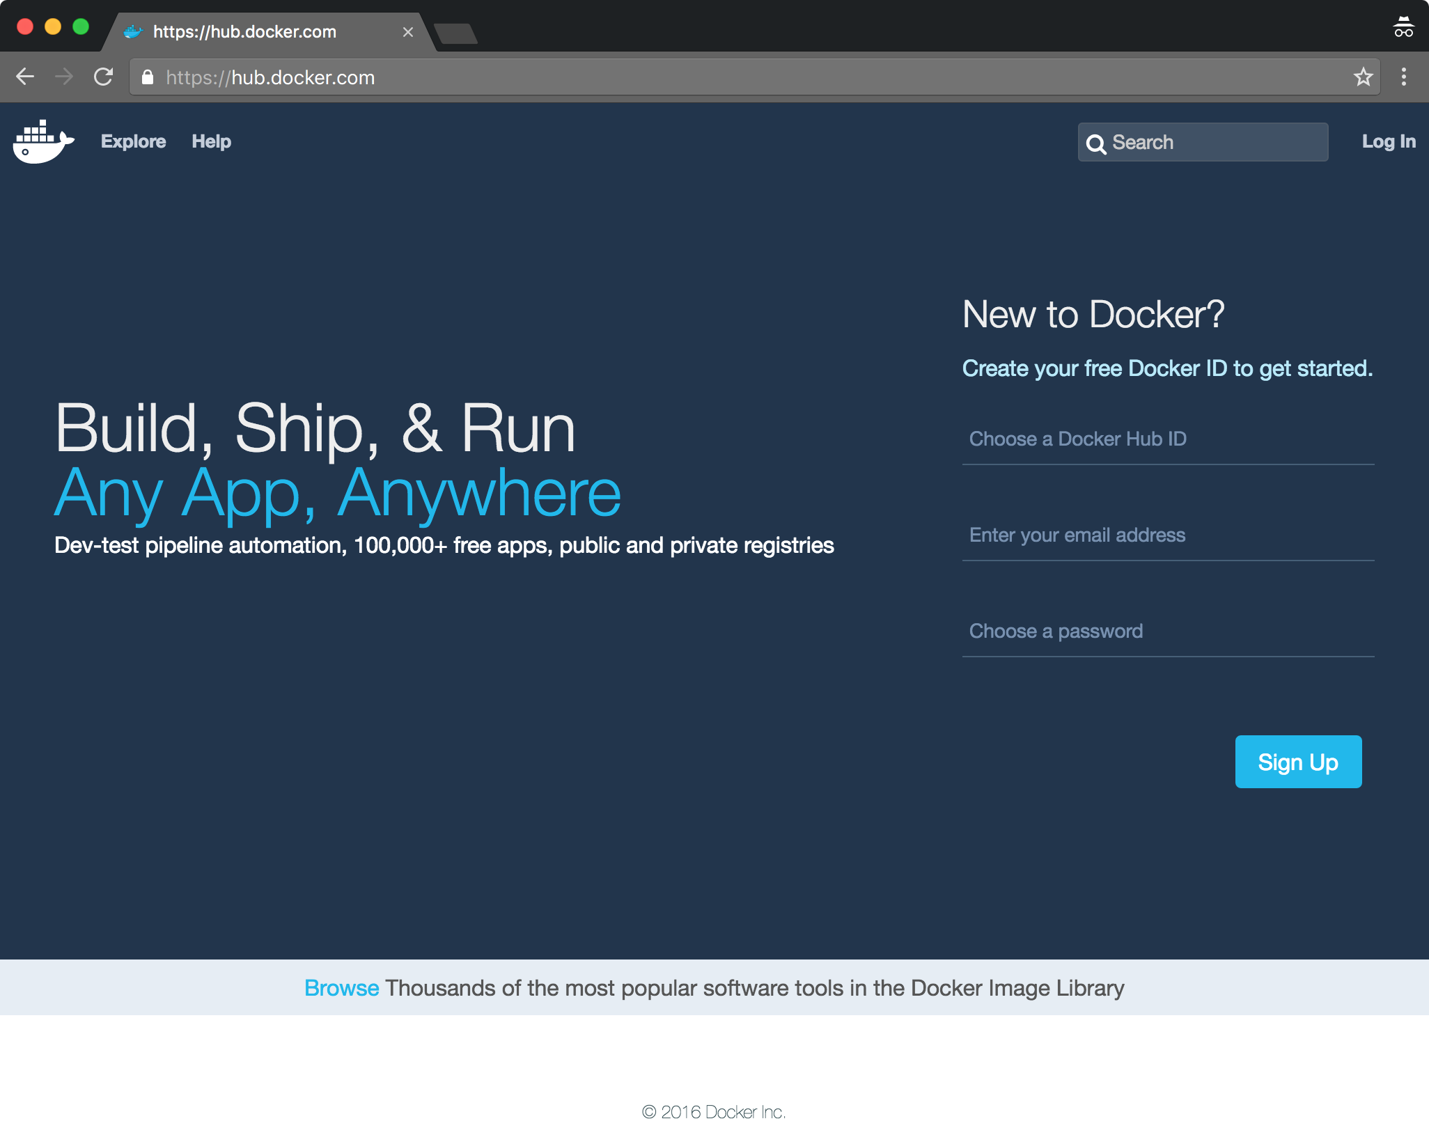
The Docker Hub
The Docker Hub is a registry supporting dynamic container image download
Docker Hub hosts many base images
Cirros
Ubuntu
Fedora
Debian
Centos
etc .
These images can be used as the basis for building custom application service images
Our prior example automatically downloaded the minimal Cirros Linux cloud image and then ran a Bourne shell within the container
When docker can not find an image locally it looks for the image in a registry, like DockerHub
Docker Hub also hosts ready to run service images
MongoDB, Cassandra, Apache, Nginx, Redis, WordPress, …
And dev platform images
Java, NodeJS, Ruby, Python, …

Slide 31
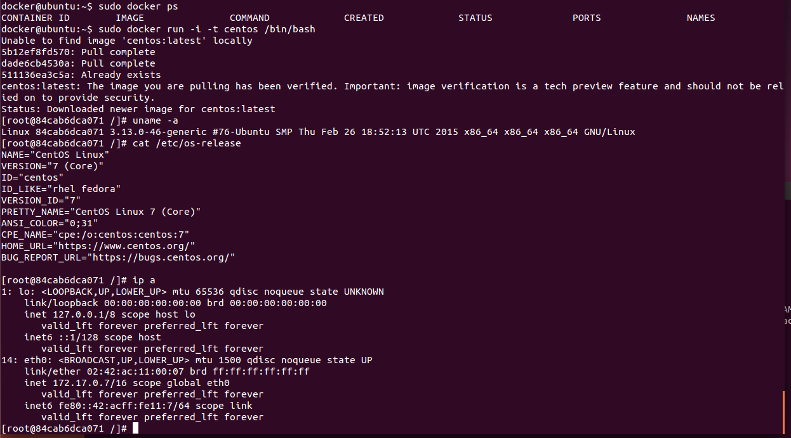
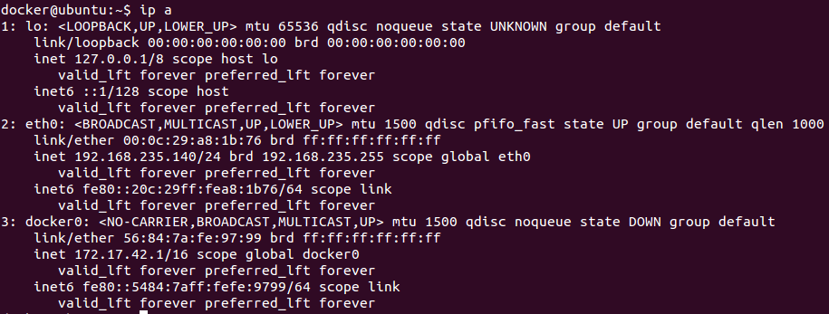
Exploring a Centos Container
The base centos image is 218MB, this is less than half the size of a base Centos server VM
Running containers share the host kernel but supply their own OS personality
Libraries, executables, configuration files, etc
Running containers also have their own network interfaces

Slide 32
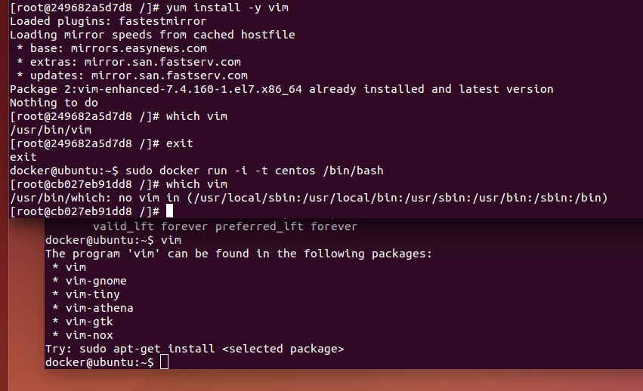
Container Isolation
Images create copy on write container layers
Changes made to containers are isolated from the host and other container instances
e.g. installing vim in a container makes it available to that container only
The host will not have vim installed
Other containers generated from the same image will not have vim installed
This ensures that every container generated from a given image shares the same, predictable, repeatable, initial state

Slide 33
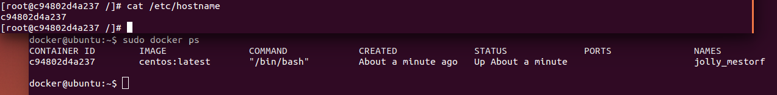
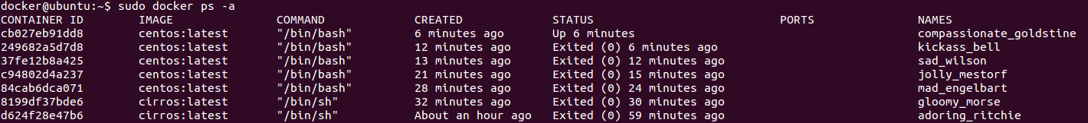
Listing Containers
Containers have (at least) 3 Names
ID
Container Name
Hostname
Docker commands can reference containers by ID or Container Name
Short versions of the IDs are displayed by default
Container names:
Are generated if not provided (random adjective + _ + random last name)
docker run --name switch allows the name to be set explicitly
docker rename command allows you to rename an existing container
Container names must be unique within the scope of a particular docker daemon
Containers use their container ID as their Hostname by default
The container Hostname can be set with the -h (or --hostname) switch
The docker ps subcommand displays running containers
The -a switch (or --all) displays all containers (running and stopped)

Slide 34
Filtering Container Lists
The -f (--filter) switch allows you to filter ps output based on conditions
Conditions are provided as key=value pairs
You can pass multiple filter flags (e.g. --filter "foo=bar" --filter "bif=baz")
Supported filter tags:
id (container’s id)
label (label=<key> or label=<key>=<value>)
name (container’s name)
exited (int - the code of exited containers. Only useful with --all)
status (created|restarting|running|paused|exited|dead)
ancestor (<image-name>[:<tag>], <image id> or <image@digest>) - filters containers that were created from the given image or a descendant.
before (container’s id or name) - filters containers created before given id or name
since (container’s id or name) - filters containers created since given id or name
isolation (default|process|hyperv) (Windows daemon only)
volume (volume name or mount point) - filters containers that mount volumes.
network (network id or name) - filters containers connected to the provided network
user@ubuntu:~$ docker ps -a
CONTAINER ID IMAGE COMMAND CREATED STATUS PORTS NAMES
6b4b4604a141 alpine "sh" 3 seconds ago Created modest_hawking
d56b7c2999d5 ubuntu "/bin/bash" 29 seconds ago Exited (0) 28 seconds ago pensive_turing
184c60beee53 alpine "sh -c 'while true; d" About an hour ago Up About an hour Zugspitze
user@ubuntu:~$ docker ps -f status=created
CONTAINER ID IMAGE COMMAND CREATED STATUS PORTS NAMES
6b4b4604a141 alpine "sh" 41 seconds ago Created modest_hawking

Slide 35
Filtering ancestry
Filtering by container image is particularly useful
-f ancestor=<image name>
The image name must be an exact match of the name used to launch the container (and displayed by docker ps)
user@ubuntu:~$ docker ps
CONTAINER ID IMAGE COMMAND CREATED STATUS PORTS NAMES
f90a992e545c nginx "nginx -g 'daemon off" 5 minutes ago Up 5 minutes 80/tcp, 443/tcp elated_jepsen
f5df48bbae86 nginx "nginx -g 'daemon off" 6 minutes ago Up 6 minutes 80/tcp, 443/tcp lonely_albattani
d042fea85262 ubuntu "/bin/bash" 14 minutes ago Up 14 minutes prickly_dubinsky
886a27f9b99c ubuntu "/bin/bash" 15 minutes ago Up 15 minutes infallible_rosalind
user@ubuntu:~$ docker ps -f ancestor=nginx
CONTAINER ID IMAGE COMMAND CREATED STATUS PORTS NAMES
f90a992e545c nginx "nginx -g 'daemon off" 6 minutes ago Up 6 minutes 80/tcp, 443/tcp elated_jepsen
f5df48bbae86 nginx "nginx -g 'daemon off" 6 minutes ago Up 6 minutes 80/tcp, 443/tcp lonely_albattani

Slide 36
Filtering with labels
Containers can be assigned arbitrary labels (key/value strings) using the --label switch with docker run
Containers can then be listed with docker ps based on labels
You can list containers with a given key
You can also list containers with a given key and a given value
user@ubuntu:~$ docker run -itd --label="loc=dallas" ubuntu
886a27f9b99cb46aadc58b894952731f762f1e2a4017d217c3723a95f120b637
user@ubuntu:~$ docker run -itd --label="loc=portland" ubuntu
d042fea85262911863bc0c09f6c97433f612bf3c9c8eef4992737e15976bd169
user@ubuntu:~$ docker ps -f="label=loc"
CONTAINER ID IMAGE COMMAND CREATED STATUS PORTS NAMES
d042fea85262 ubuntu "/bin/bash" About a minute ago Up About a minute prickly_dubinsky
886a27f9b99c ubuntu "/bin/bash" About a minute ago Up About a minute infallible_rosalind
user@ubuntu:~$ docker ps -f="label=loc=dallas"
CONTAINER ID IMAGE COMMAND CREATED STATUS PORTS NAMES
886a27f9b99c ubuntu "/bin/bash" About a minute ago Up About a minute infallible_rosalind
user@ubuntu:~$ docker ps
CONTAINER ID IMAGE COMMAND CREATED STATUS PORTS NAMES
d042fea85262 ubuntu "/bin/bash" About a minute ago Up About a minute prickly_dubinsky
886a27f9b99c ubuntu "/bin/bash" About a minute ago Up About a minute infallible_rosalind
2ec0f1d5e892 ubuntu "/bin/bash" 22 minutes ago Up 22 minutes mad_blackwell
8faa3d0adf53 ubuntu "/bin/bash" 22 minutes ago Up 22 minutes prickly_wright
user@ubuntu:~$

Slide 37
Formatting ps output
The docker ps --format switch allows you to customize the ps output
The format spec must be a valid Go template
Adding the “table” prefix displays column headings
Fields supported:
.ID Container ID
.Image Image ID
.Command Quoted command
.CreatedAt Time when the container was created.
.RunningFor Elapsed time since the container was started.
.Ports Exposed ports.
.Status Container status.
.Size Container disk size.
.Names Container names.
.Labels All labels assigned to the container.
.Label Value of a specific label for this container, e.g. '{{.Label "com.docker.swarm.cpu"}}'
.Mounts Names of the volumes mounted in this container.
Go Template Documentation
https://golang.org/pkg/text/template/
user@ubuntu:~$ docker ps --format "table {{.ID}}\t{{.Names}}\t{{.Labels}}"
CONTAINER ID NAMES LABELS
f90a992e545c elated_jepsen
f5df48bbae86 lonely_albattani
d042fea85262 prickly_dubinsky loc=portland
886a27f9b99c infallible_rosalind loc=dallas

Slide 38
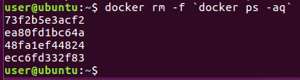
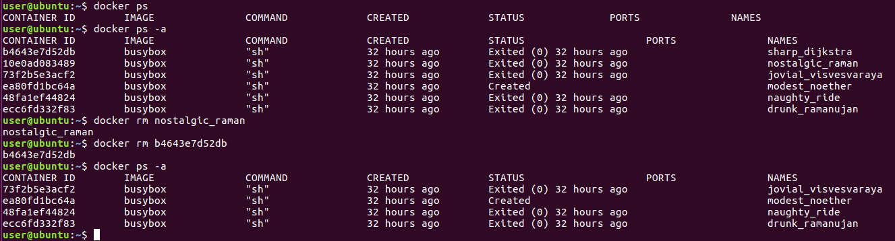
Removing Containers
The docker rm command removes containers from a host
-f, --force Force the removal of a running container (uses SIGKILL)
Prefer $(docker ps -aq) over `docker ps -aq`
http://mywiki.wooledge.org/BashFAQ/082
http://pubs.opengroup.org/onlinepubs/9699919799/xrat/V4_xcu_chap02.html#tag_23_02_06_03

Slide 39
Summary
The Docker platform includes several parts
Docker daemon (docker engine)
Docker client
Registries
Images
Containers
Containers are spawned from images and are isolated from each other and the host operating system
The docker command line tool provides an array of commands for starting, examining and controlling containers
You can control the output columns displayed by docker ps with the --format switch
You can control the output rows displayed by docker ps with the --filter switch

Slide 40
Lab 2
Running containers

Slide 41
3: Controlling Containers

Slide 42
Objectives
Explain the difference between create and run
Describe the process used to copy files between a host and a container
Explore the details of starting, stopping, pausing and unpausing containers
Learn how to attach and detach from containers
Gather container information using ps, stats and top
Execute commands within a container using nsenter and docker exec
Run containers as services and inspect their log output

Slide 43
Creating Containers
The docker create command creates a container
Creating the container filesystem from the specified image
Saving the container’s metadata (typically in a config.json)
The container ID is printed to STDOUT
Similar to docker run except the container is never started
docker run is actually just a wrapper for create and start
You can use docker start <container_id/name> to start the container
This is useful when you want to set up a container configuration ahead of time so that it is ready to start when you need it
The initial status of the new container is created
All of the switches supported by the run command can be applied to the create command
The metadata configuration file captures all of the (10s of) create/run configuration options
The start command takes no container configuration switches, it simply runs the container as per the configuration
You can specify how you would like your local terminal to be connected to the container with start (e.g. -i)
user@ubuntu:~$ docker create --name test99 -h nodea -t nginx
e76f0fdf16a8273e8335855e7fe0bb339306344fad8b3c4f70c1747688738128
user@ubuntu:~$ docker ps
CONTAINER ID IMAGE COMMAND CREATED STATUS PORTS NAMES
user@ubuntu:~$ docker ps -a
CONTAINER ID IMAGE COMMAND CREATED STATUS PORTS NAMES
e76f0fdf16a8 nginx "nginx -g 'daemon off" 30 seconds ago Created test99
user@ubuntu:~$ docker start test99
test99
user@ubuntu:~$ docker ps
CONTAINER ID IMAGE COMMAND CREATED STATUS PORTS NAMES
e76f0fdf16a8 nginx "nginx -g 'daemon off" 57 seconds ago Up 7 seconds 80/tcp, 443/tcp test99

Slide 44
Copying to/from Containers
docker cp <container>:<path> <hostdir>
docker cp <hostdir> <container>:<path>
Host to container direction added in docker 1.8
Note cp can copy to/from any container (it does not have to be running)
A dash (“-”) can be used to cp a tar archive to STDOUT or from STDIN
user@ubuntu:~$ docker create --name=zugspitze alpine /usr/bin/tail –f /dev/null
user@ubuntu:~$ echo "From the host" > host.md
user@ubuntu:~$ docker cp ./host.md zugspitze:/test.md
user@ubuntu:~$ docker cp zugspitze:/test.md ./cont.md
user@ubuntu:~$ cat cont.md
From the host
user@ubuntu:~$ docker cp zugspitze:/etc - > zsetcdir.tar
user@ubuntu:~$ tar -tf zsetcdir.tar | grep host
etc/hostname
etc/hosts
user@ubuntu:~$

Slide 45
Container Size
The docker ps -s switch can be used to display the size of the container’s writable layer
The virtual size includes the size of the image stack the container is based on
user@ubuntu:~$ docker ps -s
CONTAINER ID IMAGE COMMAND CREATED STATUS PORTS NAMES SIZE
2ec0f1d5e892 ubuntu "/bin/bash" 14 minutes ago Up 14 minutes mad_blackwell 29 B (virtual 126.4 MB)
8faa3d0adf53 ubuntu "/bin/bash" 14 minutes ago Up 14 minutes prickly_wright 0 B (virtual 126.4 MB)
user@ubuntu:~$ docker exec mad_blackwell sh -c 'echo Hello > readme'
user@ubuntu:~$ docker ps -s
CONTAINER ID IMAGE COMMAND CREATED STATUS PORTS NAMES SIZE
2ec0f1d5e892 ubuntu "/bin/bash" 14 minutes ago Up 14 minutes mad_blackwell 35 B (virtual 126.4 MB)
8faa3d0adf53 ubuntu "/bin/bash" 14 minutes ago Up 14 minutes prickly_wright 0 B (virtual 126.4 MB)
user@ubuntu:~$

Slide 46
Controlling Containers
docker start
You can resume a stopped container using the start sub command
To reconnect your local shell input stream to the container use the -i switch
docker restart
The restart command stops the specified container and then runs it again
If the container is not already running, restart simply starts it
docker stop
You can stop a running container with the stop command
Sends SIGINT, waits 10 seconds, sends SIGKILL
You can set the delay in seconds between the two SIGs with the -t switch (also works with restart)
user@ubuntu:~$ docker create --name=zugspitze alpine /usr/bin/tail -f /dev/null
3d232d3591cf900a5d6d6040e61bc46840b07785e001ed25d9c3f958cb9bf164
user@ubuntu:~$ docker ps
CONTAINER ID IMAGE COMMAND CREATED STATUS PORTS NAMES
user@ubuntu:~$ docker ps -a
CONTAINER ID IMAGE COMMAND CREATED STATUS PORTS NAMES
3d232d3591cf alpine "/usr/bin/tail -f /de" 7 seconds ago Created zugspitze
user@ubuntu:~$ docker start zugspitze
zugspitze
user@ubuntu:~$ docker ps
CONTAINER ID IMAGE COMMAND CREATED STATUS PORTS NAMES
3d232d3591cf alpine "/usr/bin/tail -f /de" 22 seconds ago Up 6 seconds zugspitze
user@ubuntu:~$ time docker stop zugspitze
zugspitze
real 0m10.201s
user 0m0.004s
sys 0m0.004s
user@ubuntu:~$ docker ps
CONTAINER ID IMAGE COMMAND CREATED STATUS PORTS NAMES
user@ubuntu:~$ docker restart zugspitze
zugspitze
user@ubuntu:~$ docker ps
CONTAINER ID IMAGE COMMAND CREATED STATUS PORTS NAMES
3d232d3591cf alpine "/usr/bin/tail -f /de" 2 minutes ago Up 4 seconds zugspitze
user@ubuntu:~$ docker restart zugspitze
dockerzugspitze
user@ubuntu:~$ docker ps
CONTAINER ID IMAGE COMMAND CREATED STATUS PORTS NAMES
3d232d3591cf alpine "/usr/bin/tail -f /de" 2 minutes ago Up 1 seconds zugspitze
user@ubuntu:~$ time docker stop -t=1 zugspitze
zugspitze
real 0m1.201s
user 0m0.004s
sys 0m0.004s
user@ubuntu:~$

Slide 47
Attach
docker attach
You can attach to a running container using the attach subcommand
This attaches your shell to PID 1 in the container
Not all programs running in a container offer a useful console
The ^p ^q sequence detaches from a container (if you are attached to a shell in the container)
The --detach-keys switch sets a different detach sequence
user@ubuntu:~$ docker run -itd ubuntu:12.04
7f5a4ebf67ac551f2ce197b2cd493217b193231f707a1a1bfefa803cd37e8f36
user@ubuntu:~$ docker attach 7f5a
root@7f5a4ebf67ac:/# ps
PID TTY TIME CMD
1 ? 00:00:00 bash
10 ? 00:00:00 ps
root@7f5a4ebf67ac:/# (CTRL-p CTRL-q pressed)
user@ubuntu:~$ docker attach --detach-keys="ctrl-a,ctrl-a" 7f5a
root@7f5a4ebf67ac:/# ps
PID TTY TIME CMD
1 ? 00:00:00 bash
11 ? 00:00:00 ps
root@7f5a4ebf67ac:/# (CTRL-a CTRL-a pressed)
user@ubuntu:~$

Slide 48
Types of Containers
Containers can be organized into categories designating their purpose
Application Containers
Executable containers
$ docker run thrift --gen cpp myidl.thrift
Containers of this type are designed to distribute command line tools
The advantage is that the container allows the binary to run on any flavor on Linux with Docker installed without building from source or installing an interpreter
Service Containers
$ docker run -d my_co_webserver
Containers of this type are designed to house application services
Simplifies application deployment
Machine Containers
$ docker run -it centos /bin/bash
Containers of this type are designed to house the non kernel elements of a Linux distro
Allows you to run and test any Linux distro on a single Linux base OS, also used as a base for service images
Can be deployed to support admin tasks
Executable Containers
(acts like a CL executable)
RHEL/kernel
Application Container
Python App Image
Nginx Image
Ubuntu Image
Service Containers
(runs like a daemon)
Hardware
RHEL/kernel
Machine Containers
(feels like a VM)
Machine Container
Ubuntu Image
Hardware

Slide 49
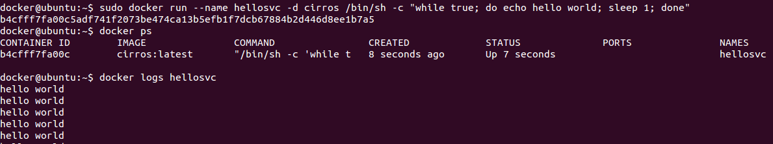
Containers as Services
Containers are commonly executed in the background as daemons on servers
The -d (detach) switch runs a container in daemon mode
daemonized containers do not have an interactive session

Slide 50
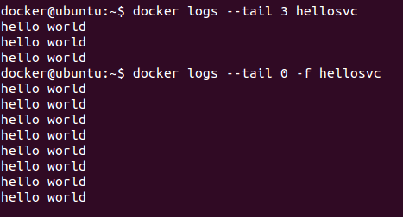
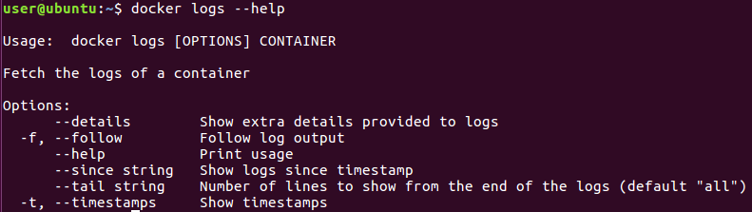
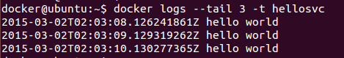
Container Logs
The docker “logs” subcommand displays the specified container’s STDOUT/STDERR log
The logs command supports the --tail switch
Tail will display the last n lines of the log
Adding -f (--follow) will tail continuously
Adding -t (--timestamps) will display the log entry timestamp
--since can be used to display events more recent than a given timestamp
The –details switch will display log-options set by the user at run time

Slide 51
Pause and Unpause
Pause suspends a container’s execution but leaves it resident in memory
This stops the execution of all processes and threads within the container
Unpause releases a container from the pause state
user@ubuntu:~$ docker run -d --name=zugspitze alpine sh -c 'while true; do echo "hello world"; sleep 3; done'
184c60beee53016c990be5b6a580610a16d1e619b97048047bb960b17934064e
user@ubuntu:~$ docker ps
CONTAINER ID IMAGE COMMAND CREATED STATUS PORTS NAMES
184c60beee53 alpine "sh -c 'while true; d" 3 seconds ago Up 2 seconds zugspitze
user@ubuntu:~$ docker logs zugspitze
hello world
hello world
hello world
hello world
user@ubuntu:~$ docker pause zugspitze
zugspitze
user@ubuntu:~$ docker logs zugspitze | wc -l
8
user@ubuntu:~$ sleep 5
user@ubuntu:~$ docker logs zugspitze | wc -l
8
user@ubuntu:~$ docker ps
CONTAINER ID IMAGE COMMAND CREATED STATUS PORTS NAMES
184c60beee53 alpine "sh -c 'while true; d" 52 seconds ago Up 51 seconds (Paused) zugspitze
user@ubuntu:~$ docker unpause zugspitze
zugspitze
user@ubuntu:~$ docker ps
CONTAINER ID IMAGE COMMAND CREATED STATUS PORTS NAMES
184c60beee53 alpine "sh -c 'while true; d" About a minute ago Up About a minute zugspitze
user@ubuntu:~$ docker logs zugspitze | wc -l
12
user@ubuntu:~$

Slide 52
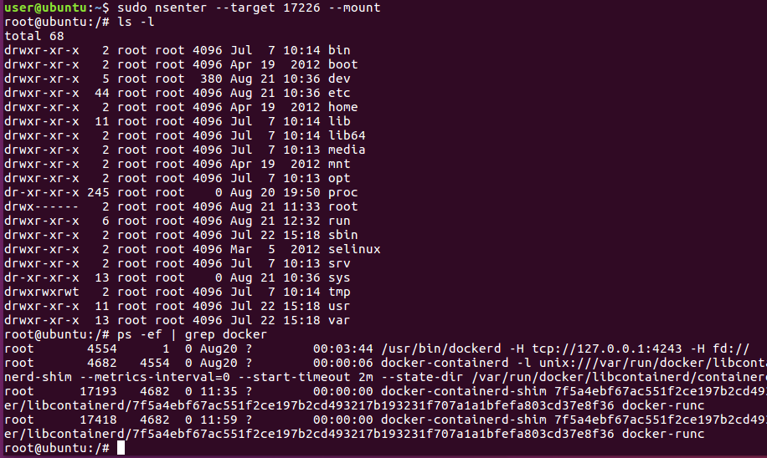
Exec
docker exec <container> <cmd> (added in docker 1.3)
Runs an arbitrary process within a container (all namespaces and cgroups in force)
-d runs new process detached
-I runs new process in interactive mode
Linux also offers the nsenter command
Enters the namespaces of another process and then executes the specified program
Allows you to choose the namespace(s) to enter and ignores cgroup constraints of the target process
user@ubuntu:~$ docker exec 7f5a cat /etc/os-release
NAME="Ubuntu"
VERSION="12.04.5 LTS, Precise Pangolin"
ID=ubuntu
ID_LIKE=debian
PRETTY_NAME="Ubuntu precise (12.04.5 LTS)"
VERSION_ID="12.04"
user@ubuntu:~$ docker exec -it 7f5a /bin/bash
root@7f5a4ebf67ac:/# ps
PID TTY TIME CMD
27 ? 00:00:00 bash
37 ? 00:00:00 ps
root@7f5a4ebf67ac:/# exit
exit
user@ubuntu:~$ docker ps
CONTAINER ID IMAGE COMMAND CREATED STATUS PORTS NAMES
7f5a4ebf67ac ubuntu:12.04 "/bin/bash" 50 minutes ago Up 50 minutes silly_carson
user@ubuntu:~$ docker top 7f5a
UID PID PPID C STIME TTY TIME CMD
root 17226 17193 0 04:09 pts/12 00:00:00 /bin/bash
user@ubuntu:~$ sudo nsenter --target 17226 --mount --uts --ipc --net --pid
root@7f5a4ebf67ac:/# ps -ef
UID PID PPID C STIME TTY TIME CMD
root 1 0 0 11:09 ? 00:00:00 /bin/bash
root 12 0 0 11:28 ? 00:00:00 -bash
root 15 12 0 11:28 ? 00:00:00 ps -ef
root@7f5a4ebf67ac:/# exit
logout
user@ubuntu:~$

Slide 53
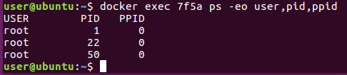
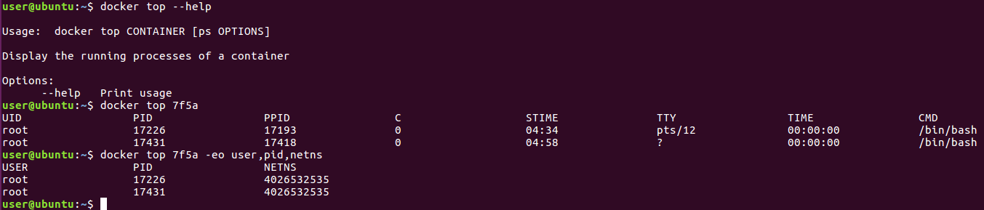
Top
Just like docker ps should have been called docker ls …
docker top (should have been called docker ps)
You can examine the processes running within a container using the top subcommand
Top accepts standard ps switches
Note that containers provide a passive operating system and library interface with no running processes or services enabled by default
Docker containers supply processes with a PID namespace allowing them to see only the other processes within the container
Process IDs within the container start with 1 and are mapped to available PIDs on the host
ps inside the container shows PID namespace local PIDs and top shows host relative PIDs

Slide 54
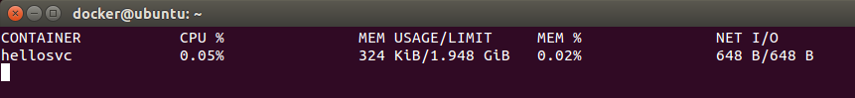
Stats
docker stats (added in docker 1.5)
The stats sub command displays a live status view of the specified containers
The --no-stream switch executes a one shot stats
The -a switch displays states for all containers
Without arguments stats displays all running containers
Stats shows summary data for the entire container (not by process)

Slide 55
Summary
Containers can be created prior to starting them
A container need not be running to copy files in and out of it
Containers can be started multiple times
docker stop sends signals to the container’s PID 1 process
You can attach to and detach from a containers PID 1 process
docker ps and top tools allow you to display custom data describing containers
docker exec allows you to execute arbitrary processes within a container
nseneter allows you to execute processes that use only the specified namespaces of the container
docker logs allows you to view the log output of containers

Slide 56
Lab 3
Controlling containers

Slide 57
4: Advanced Container Operations

Slide 58
Objectives
Become familiar with the evolution of Docker and container technology
Describe the relationship between Docker and the OCI
List the OCI components of the Docker daemon stack
Describe the Docker daemon and client configuration options
Explore Docker container metadata
Work with Docker environment variables, signals and events
Use container restart policies

Slide 59
Container & Docker Timeline
2005 OpenVZ (Previously Parallels [SWsoft] Virtuozzo containers) open sourced [Linux 2.6.11]
2006 Google (Menage/Seth) add Process Containers to Linux (now called CGroups) [Linux 2.6.15]
2007 Google uses cgroups to containerize search [Linux 2.6.20]
2008 LXC version 0.1.0 released (basic functions) [Linux 2.6.24]
2009 First LTS Linux release with official LXC support [Linux 2.6.32 LTS]
2011 Container Unification agreement during kernel summit (In tree unified CGroups and Namespaces resulted)
dotCloud raises $12mm Series A to create a PaaS framework
2012 First 3.x LTS kernels [Linux 3.2 & 3.4 LTS]
2013 First Linux kernel with full container support for all container systems (LXC, Docker, OpenVZ, etc.) [Linux 3.10 & 3.12 LTS]
dotCloud pivots, becoming Docker Inc. and adds docker support to OpenStack Havana (not part of Icehouse+)
Google ComputeEngine adds Docker support
2014-01 – Docker Inc. raises $15M series B
2014-04 – Docker Governance Advisory Board (DGAB), a step toward Docker open governance
Amazon integrates Docker with Elastic Beanstalk
Ubuntu 14.04 ships with native Docker packages
RHEL 7 offers Docker support and Red Hat certified containers
2014-06 – Docker 1.0 released, commercial support by Docker Inc. and 1st DockerCon
2014-07 – Docker 1.1 released (Docker Engine + Docker Hub + APIs + expanded ecosystem)
Docker Inc. acquires Orchard (Fig renamed Compose)
2014 Linux Distros began enabling user namespaces [Linux 3.14 & 3.18 LTS]
2014-08 – Docker 1.2 released with many general improvements
Docker VMWare partnership announced
2014-09 – Docker Inc. raises $40M series C
2014-10 – Docker 1.3 released with support for signed images
Docker Microsoft partnership announced
2014-11 – Amazon announces Docker container support in EC2 Container Service
2014-12 – Docker 1.4 released to improve stability
2015-02 – Docker 1.5 released with support for IPv6 and read-only containers
Docker releases Orchestration tools: Machine, Swarm and Compose
2015-04 – Docker 1.6 with Registry 2.0 and Windows Client Preview
Docker raises $95mm series D [> $1bn valuation] - Insight, Coatue, Goldman Sachs, Northern Trust, Benchmark, Greylock, Sequoia, Trinity & AME
Docker Acquires Kitematic (Mac GUI) and SocketPlane (Container Networking)
2015-06 – Docker 1.7 released with many performance tweaks
Linux Foundation - Open Container Initiative [OCI] with libcontainer as base
2015-07 – Docker 1.7.1 released with several important bug fixes
FreeBSD announces Docker support via 64bit Linux compatibility layer
Linux Foundation - Container Native Computing Foundation [CNCF] with Kubernetes as base
2015-08 – Docker 1.8 released with support for pluggable volume backends
1.8 bug corrupts images pushed with multiple tags, 1.8.1 fix a week later, other fixes/security patches lead to 1.8.3 in 2015-10-12
2015-10 – Docker Inc. acquires DevOps/Container orchestration and management platform TuTum
2015-11 – Docker 1.9 released with support for multi-host networking and named volumes
2016-01 – Docker acquires Unikernel Systems (folks from the Xen Project)
2016-02 – Docker 1.10 released with support for user namespaces, SecComp and DNS container name resolution
2016-03 – Docker Cloud released with automated deployment to AWS, DigitalOcean, SoftLayer and Azure
2016-04 – Docker v1.11 released with OCI support (built on containerd and runC)
2016-08 – Docker v1.12 released with integrated cluster management (Swarm Mode)
Docker Inc. roadmap on GitHub:
(updated 2016-08)
https://github.com/docker/docker/blob/master/ROADMAP.md

Slide 60
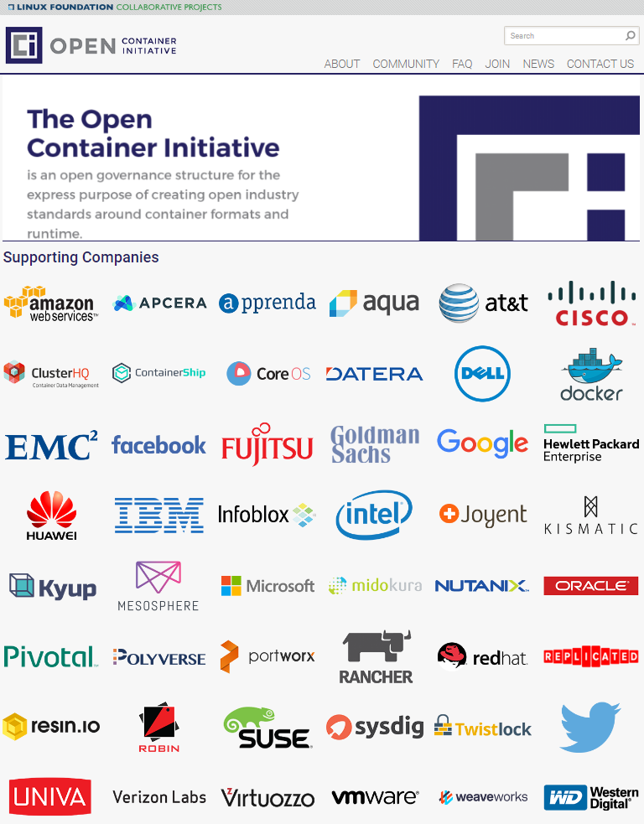
Container Standardization
OCI [circa 6/2015]
Open Container Initiative
Formerly Open Container Project
OCI seeks to create open industry standards around container formats and runtime
A standard that ensures any container can run on any machines or cloud computing service
Run by the Linux Foundation
Non-profit which oversees the Linux open source operating system
Docker donated the container format, runtime code (libcontainer) and specifications
Members (All of the tech companies in the Fortune 100 except Apple, all of the key container startups):
Amazon, Apcera, Apprenda, Aqua, AT&T, ClusterHQ, Cisco, CoreOS, ContainerShip, Datera, Dell, Docker, EMC, Facebook, Fujitsu Limited, Goldman Sachs, Google, Hewlett Packard Enterprise, Huawei, IBM, Infoblox, Intel, Joyent, Kismatic, Kyup, Mesosphere, Microsoft, Midokura, Nutanix, Odin (Virtuozzo), Oracle, Pivotal, Polyverse, Portworx, Rancher Labs, Red Hat, Replicated, Resin.io, Robin, Scalock, Sysdig, SUSE, Twistlock, Twitter, Univa, Verizon Labs, Vmware, Weaveworks and WD

Slide 61
Container Enablers
Docker installations include the following elements:
Docker daemon [dockerd] – daemon performing high level container management
https://github.com/docker/docker
containerd [runc manager] – daemon directly managing OCI containers (used by Docker v1.11+)
https://github.com/docker/containerd
runc [launcher] – OCI container launcher (used by Docker v1.11+)
https://github.com/opencontainers/runc
libcontainer [system interface] – OCI kernel container interface (used by Docker v0.9+)
https://github.com/opencontainers/runc/tree/master/libcontainer
Linux lxc is no longer supported by Docker
The Parallels (now Odin) libct interface was merged with libcontainer in mid 2014
RedHat’s project atomic has containerized user mode Linux with libcontainer
Now the standard container library/format of the OCI
Namespaces [Isolation] – Linux kernel process namespaces
Filesystem isolation: each container has its own root filesystem
Copy-on-write (COW) minimizing disk usage
Process isolation: each container runs in its own process environment
Network isolation: separate virtual interfaces and IP addressing between containers
IPC isolation: interprocess communications namespace (shared mem/mqueues, etc.)
User isolation: each container has its own set of users (full kernel support in 3.11 and Docker v1.10+)
UTS isolation: each container has its own hostname
Cgroup isolation: each container has its own Cgroup root (new in kernel 4.6, not used by Docker)
http://lkml.iu.edu/hypermail/linux/kernel/1603.2/02432.html (Cgroup PR)
http://lkml.iu.edu/hypermail/linux/kernel/1603.2/02433.html (Namespaces PR)
CGroups [Constraints] - Linux kernel process control groups
Resource constraints: resources like CPU, memory and I/O are constrained, container by container, using kernel control groups
Docker Engine
containerd
runC
libcontainer
container
container
container
Linux kernel features [namespaces, cgroups, …]
user@ubuntu:~$ ps -f `pgrep docker`
UID PID PPID C STIME TTY STAT TIME CMD
root 4545 1 1 12:29 ? Ssl 0:18 /usr/bin/dockerd -H fd://
root 4682 4545 0 12:29 ? Ssl 0:00 docker-containerd -l unix:///var/run/docker/libcontainerd/docker-containerd.sock --shim docker-containerd-shim --m
user@ubuntu:~$

Slide 62
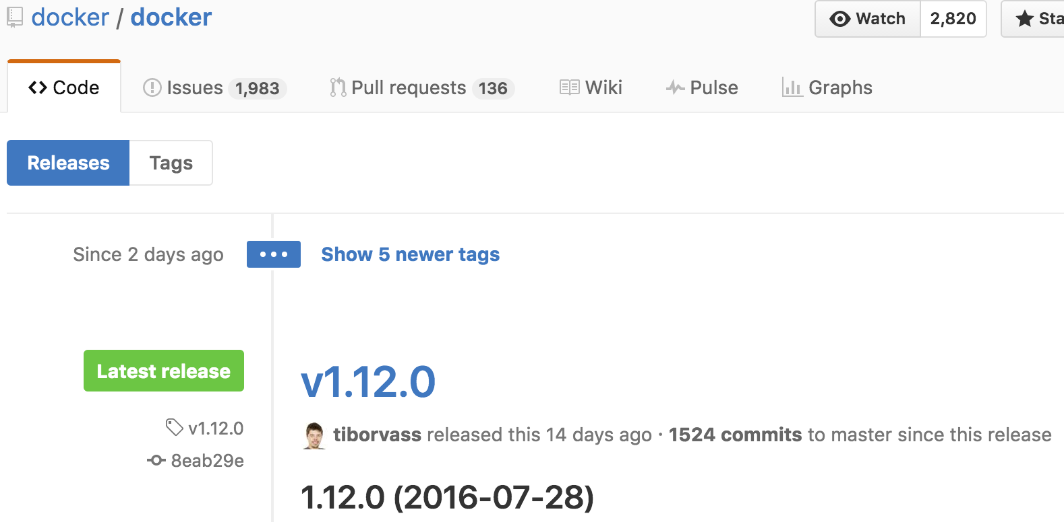
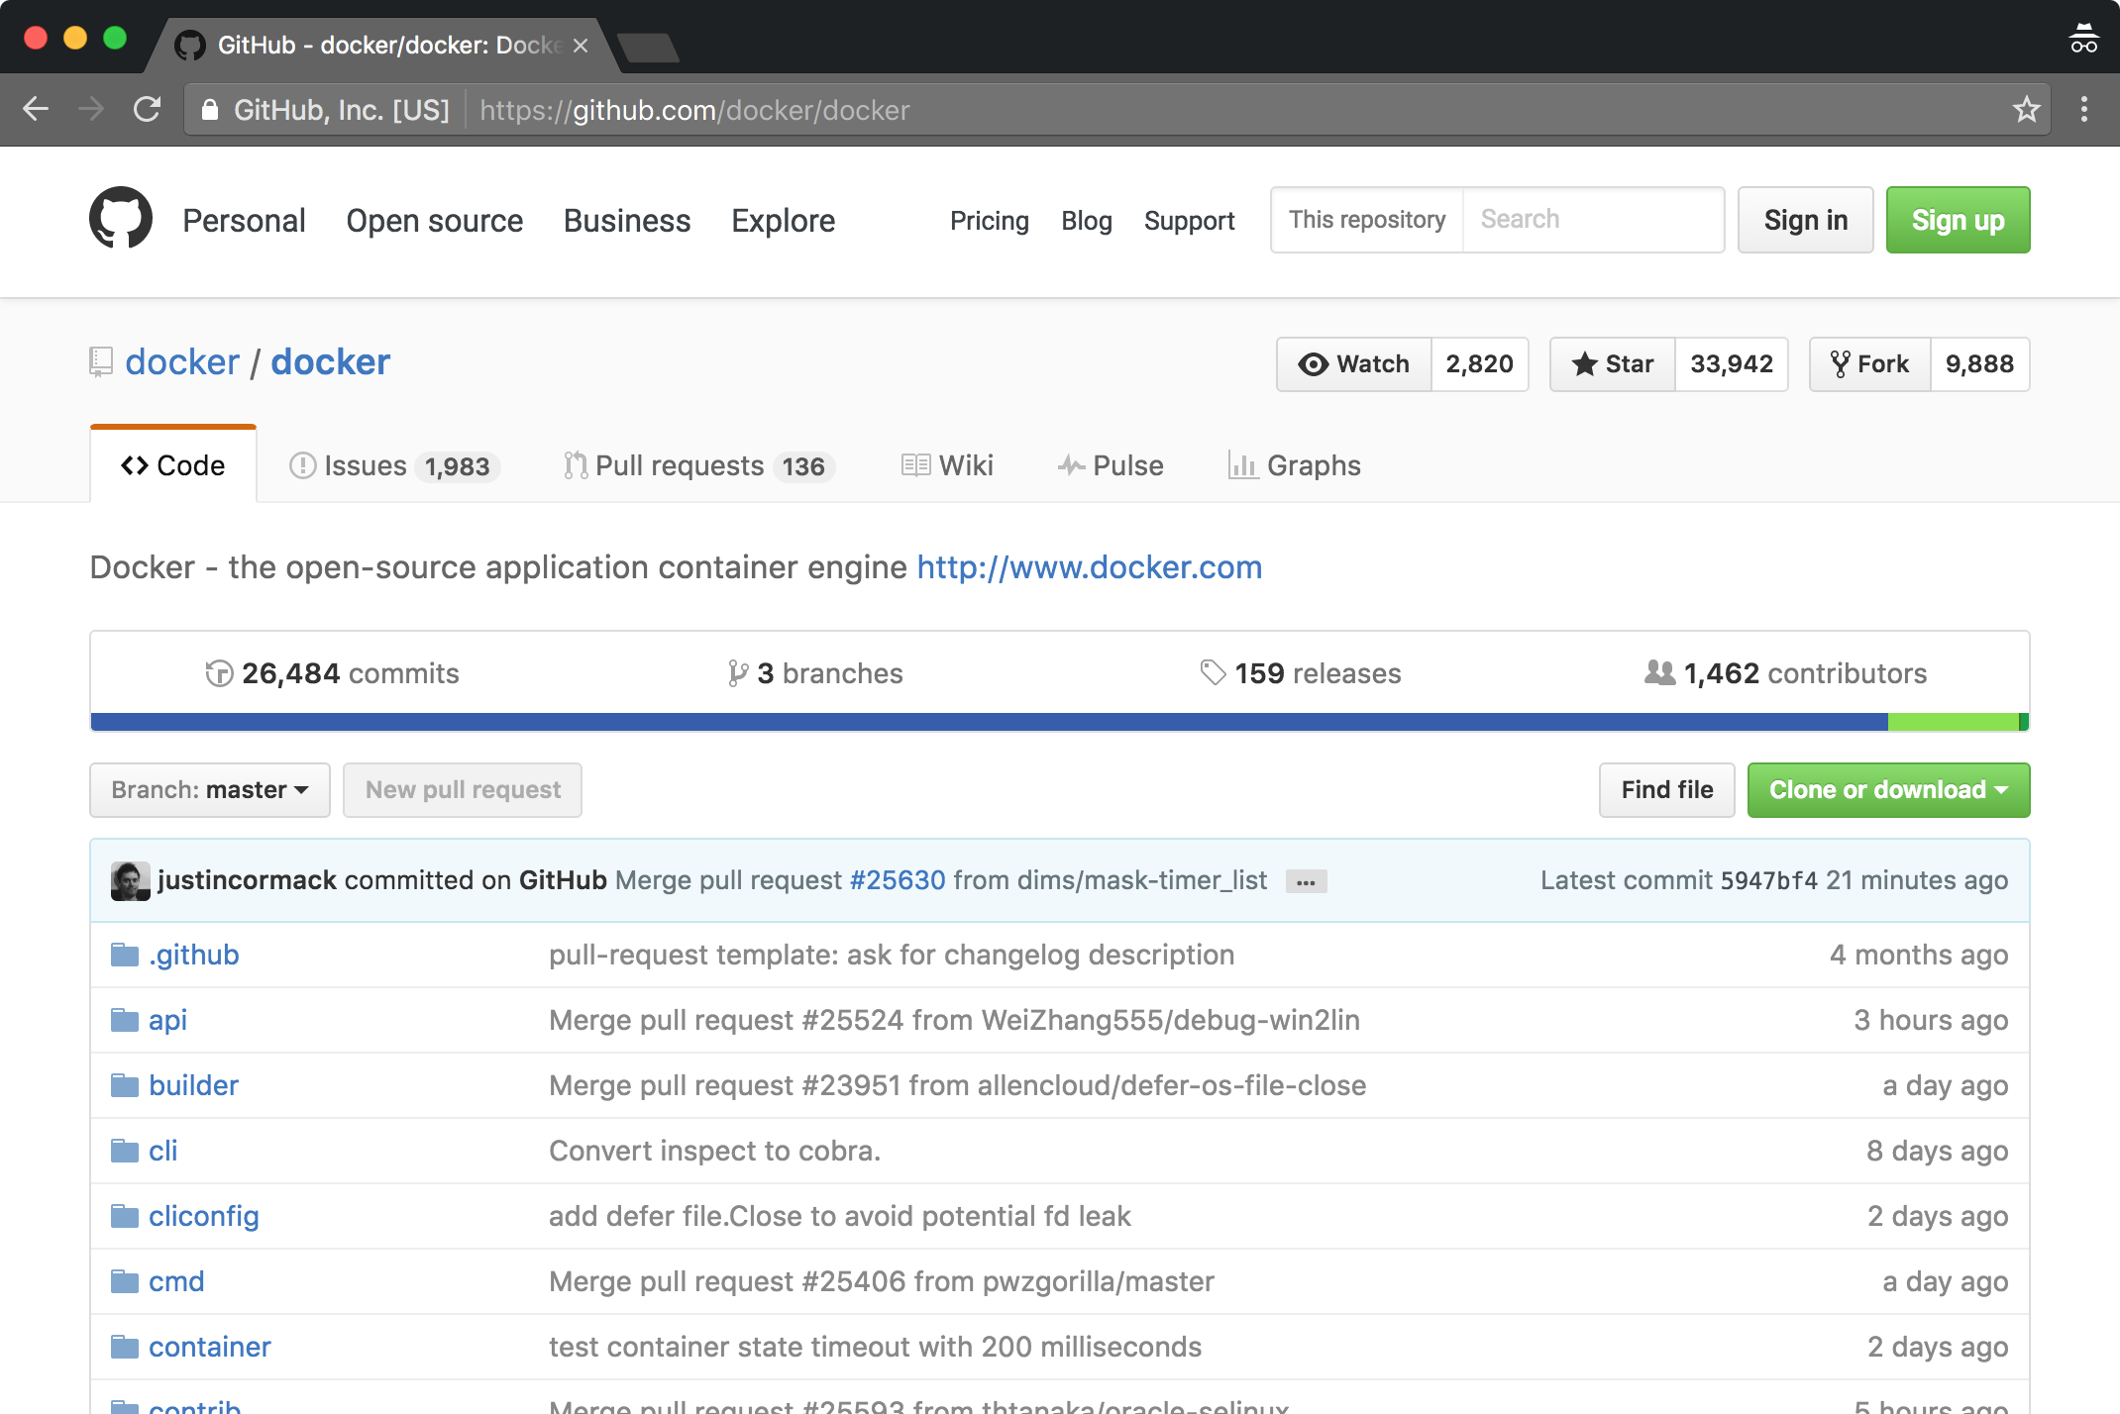
Container Tools Source
Docker, Kubernetes, etcd, and most other container tools are written in Go
Go (aka. golang) is a programming language developed at Google in 2007 by Robert Griesemer, Rob Pike, and Ken Thompson
Statically-typed
Loosely derived from C
Garbage collection
Type safety
Some dynamic-typing capabilities
Built-in types including variable-length arrays and key-value maps
A large standard library
Now used in some of Google's production systems
Go's primary "gc" compiler targets Linux, Mac OS X, FreeBSD, NetBSD, OpenBSD, Plan 9, and Windows
i386, amd64, ARM and IBM POWER processors
Go’s secondary “gccgo” compiler is a GCC frontend
Go has become the language of containers; container systems written in Go include:
Docker, Rocket, Kubernetes, etcd, Deis (based on Kubernetes), Flynn, Consul, kv, runC and libcontainer
The Docker source code can be found on GitHub
https://github.com/docker/docker

Slide 63
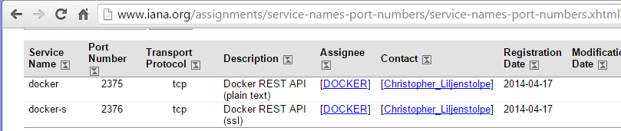
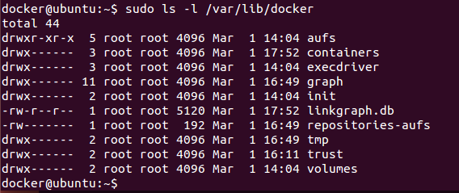
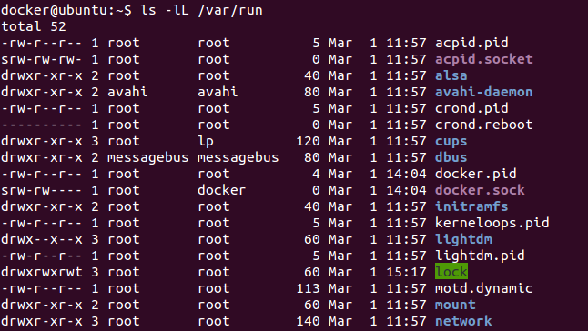
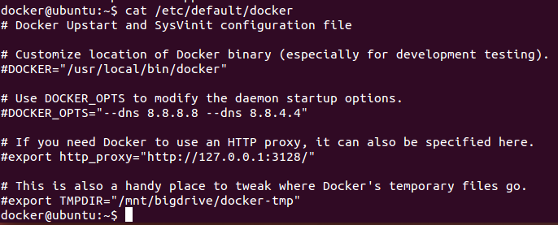
Docker Daemon
The Docker daemon runs automatically when installed from packages
/usr/bin/dockerd
The daemon listens on a Unix socket
/var/run/docker.sock
The “docker” group owns the socket, users in that group can communicate with the daemon without sudo
The -H switch instructs docker to bind to a port
You can pass multiple -H switches
sudo docker daemon -H tcp://0.0.0.0:2375
Listen on port 4444 on all interfaces
sudo docker daemon -H tcp://0.0.0.0:2375 \ -H unix:///home/docker/docker.sock
Listen on port 4444 on all interfaces and a unix socket
Settings are persisted in the server configuration file
/etc/default/docker #Ubuntu 14.04
/usr/lib/systemd/system/docker.service #RHEL/Centos
/lib/systemd/system/docker.service #Ubuntu 16.04
/etc/sysconfig/docker #others
The Docker daemon logs to /var/log
/var/log/upstart/docker.log #Ubuntu
/var/log/daemon.log #Centos/Debian (grep docker)
/var/log/messages #RHEL (grep docker)
Docker uses the /var/lib/docker directory as its default operating directory

Slide 64
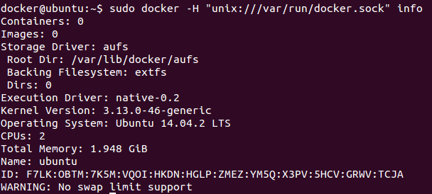
Docker Client
Client requests specify non default or remote ports with the -H switch
The DOCKER_HOST environment variable can be set as an alternative
Proxy servers can be configured with environment variables:
HTTPS_PROXY
HTTP_PROXY
NO_PROXY
Command line interface reference and help:
http://docs.docker.com/reference/commandline/cli/
Shell help:
$ docker --help
$ docker help start
$ docker help run # etc.
export DOCKER_HOST=“tcp://10.0.13.20:2375”

Slide 65
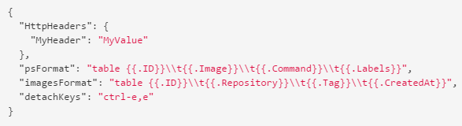

CLI Config File
You can modify the docker command behavior using:
Command-line options, which take priority over:
Environment variables, which take priority over
config.json options
Docker CLI options are stored in ~/.docker/config.json
You can specify an alternate location via:
DOCKER_CONFIG environment variable
--config command line option: docker --config ~/testconfigs/ ps
Docker manages the files in the configuration directory, config.json is the only one you should edit
config.json properties:
HttpHeaders specifies a set of headers to include in all messages sent from the Docker client to the daemon
Docker does not try to interpret or understand these headers
You can not change any headers Docker sets for itself
psFormat specifies the default format for docker ps output
When the --format flag is not provided with the docker ps command, Docker’s client uses this property
detachKeys property sets the detach key sequence
imagesFormat specifies the default format for docker images output

Slide 66
Inspect
The docker inspect subcommand displays the meta data associated with a container
All container configuration and/or descriptive data which is not part of the container’s filesystem can be found in the metadata produced by inspect
user@ubuntu:~$ docker inspect 7f5a
[
{
"Id": "7f5a4ebf67ac551f2ce197b2cd493217b193231f707a1a1bfefa803cd37e8f36",
"Created": "2016-08-21T10:36:01.189415017Z",
"Path": "/bin/bash",
"Args": [],
"State": {
"Status": "running",
"Running": true,
"Paused": false,
"Restarting": false,
"OOMKilled": false,
"Dead": false,
"Pid": 17226,
"ExitCode": 0,
"Error": "",
"StartedAt": "2016-08-21T10:36:01.782333381Z",
"FinishedAt": "0001-01-01T00:00:00Z"
},
"Image": "sha256:60df6678b2556867…df4b6a2e3d1053ce86ea63b0efd7",
"ResolvConfPath": "/var/lib/docker/containers/7f5a…cd37e8f36/resolv.conf",
"HostnamePath": "/var/lib/docker/containers/7f5a4eb…3cd37e8f36/hostname",
"HostsPath": "/var/lib/docker/containers/7f5a…f36/hosts",
"LogPath": "/var/lib/docker/containers/7f5a…f36/7f5a4…e8f36-json.log",
"Name": "/silly_carson",
"RestartCount": 0,
"Driver": "aufs",
"MountLabel": "",
"ProcessLabel": "",
"AppArmorProfile": "",
"ExecIDs": [
"60fb427aacbd9148244b594c51070043c4896926603d3d455e263561777da80b"
], }
]

Slide 67
Top Level Metadata Keys
Id – container ID
Created – timestamp of the container’s creation (not necessarily the start time)
Path – path of the executable launched as PID 1
Args – command line arguments passed to the executable
State – general run data (status, start and finish times, exit code, host relative PID, etc.)
Image – image used to launch the container (SHA hash ID)
ResolvConfPath – /etc/resolv.conf used in container
HostnamePath – /etc/hostname used in container
HostsPath – /etc/hosts used in container
LogPath – file used to capture container stdout/stderr
Name – container name
RestartCount – number of times container has been restarted by the restart policy
Driver – unioning file system driver used (aka. Graph driver)
MountLabel – the selinux context (label) for the mounts in the container
ProcessLabel – the selinux label to apply to processes running in the container
AppArmorProfile – the AppArmour profile to associate with the container
ExecIDs – IDs of any tasks executed with “docker exec” within the container
HostConfig – the host specific (non-portable) configuration settings
GraphDriver – configuration for the unioning driver
Mounts – array of volume mounts in use
Config – the portable configuration settings
NetworkSettings – network configuration

Slide 68
Particularly useful metadata
//IDENTITY
user@ubuntu:~$ docker inspect -f '{{.State.Pid}}' websvr
18263
user@ubuntu:~$ docker inspect -f '{{.Id}}' websvr
63b55d8befb430359f8727726138d530ef198aae50ef8a3d129c5812c4212351
user@ubuntu:~$ docker inspect -f '{{.Path}}' websvr
nginx
user@ubuntu:~$ docker inspect -f '{{.Args}}' websvr
[-g daemon off;]
user@ubuntu:~$ docker inspect -f '{{.Config.Image}}' websvr
nginx
//NETWORK
user@ubuntu:~$ docker inspect -f '{{.Config.Hostname}}' websvr
63b55d8befb4
user@ubuntu:~$ docker inspect -f '{{.NetworkSettings.IPAddress}}' websvr
172.17.0.3
user@ubuntu:~$ docker inspect -f '{{.NetworkSettings.MacAddress}}' websvr
02:42:ac:11:00:03
//VOLUMES
user@ubuntu:~$ docker inspect -f '{{.Mounts}}' test
[{ /home/user /myuser true rprivate}]
//STATUS
user@ubuntu:~$ docker inspect -f '{{.State.Status}}' websvr
running
user@ubuntu:~$ docker inspect -f '{{.State.ExitCode}}' websvr
0
user@ubuntu:~$ docker inspect -f '{{.Created}}' websvr
2016-08-21T16:29:52.091890205Z
user@ubuntu:~$ docker inspect -f '{{.State.StartedAt}}' websvr
2016-08-21T16:29:52.625209698Z
user@ubuntu:~$ docker inspect -f '{{.State.FinishedAt}}' websvr
0001-01-01T00:00:00Z

Slide 69
Environment Variables
When a container is started Docker sets several environment variables
HOME Set based on the value of USER
HOSTNAME The hostname associated with the container
PATH Includes std directories: /usr/local/sbin:/usr/local/bin:/usr/sbin:/usr/bin:/sbin:/bin
TERM xterm if the container is allocated a pseudo-TTY
Containers can be configured with explicit environment variables
-e, --env value Sets an environment variable
can be used multiple times on the same command line
--env-file value Read in a file of environment variables
File is k=v format with one env var per line
The environment the Docker CLI is operated from has no interaction with containers launched
user@ubuntu:~$ export TESTSUITE=REGRESSION
user@ubuntu:~$ docker run -e="TESTCASE=A8" -e=LIMIT=600 ubuntu sh -c 'echo $TESTSUITE $TESTCASE $LIMIT'
A8 600
user@ubuntu:~$ cat vars.env
TESTCASE=A8
LIMIT=600
user@ubuntu:~$ docker run --env-file=/home/user/vars.env ubuntu sh -c 'echo $TESTCASE $LIMIT'
A8 600
user@ubuntu:~$

Slide 70


Sending signals and waiting for Containers
docker kill limits the need for SSH
$ docker kill -s <signal> <container>
docker wait allows you to synchronize with containers
$ docker wait <container>
Sending SIGUSR1 to a daemon will dump all goroutines stacks without exiting

Slide 71


Signals
Processes can ignore, block, or catch all signals except SIGSTOP and SIGKILL
For a process to catch a signal it must include code that will take action when the signal is received
If the signal is not caught by the process, the kernel will take default “action” for the signal
A process running as PID 1 inside a container is treated specially by Linux
Default actions for signals other than SIGKILL and SIGSTOP are ignored
e.g. PID 1 will not terminate on SIGINT or SIGTERM unless it is coded to do so
Signal numbers are architecture dependent
Col1: alpha and sparc
Col2: x86, arm, and most other architectures
Col3: mips
http://man7.org/linux/man-pages/man7/signal.7.html

Slide 72

Restart policies
docker run --restart <repo>[:<tag>] (added in docker 1.2)
Causes docker to restart the container if it stops
100ms delay, doubling each restart to prevent flooding the server
Respected when the Docker daemon starts (e.g. after a system crash/reboot)
Three policies can be set:
no the default, never restart
always restarts the container no matter what
on-failure[:max-retry]
restart the container every time it exits with a non 0 exit code If max-retry is set the engine will try up to max-retry times to restart the container before giving up

Slide 73

Docker Engine events
The docker events subcommand allows you to monitor Docker engine events
Greatly expanded in Docker Engine v1.10 (new events in orange) (Docker v.12 additions in green)
Container events reported:
attach, commit, copy, create, destroy (rm), die (container processes exited), exec_create, exec_start, export, health_status, kill, oom (container out of memory), pause, rename, resize, restart, start, stop, top, unpause, update
Image events reported:
delete, import, pull, push, tag, untag
Volume events reported:
create, mount, unmount, destroy
Network events reported:
create, connect, disconnect, destroy

Slide 74
Summary
Linux container technology has been evolving for over a decade
Docker is a recent entry into the Linux container space but has become the dominant force
The OCI standardizes the format of containers making it possible to run an OCI compliant container in many environments (with or without Docker)
The Docker daemon and the Docker client can be configured via configuration files and command line options
Docker containers are described by metadata displayed by docker inspect
Containers can be passed environment variables on the command line or via a file
Docker containers process signals and the docker kill command can be used to send signals to a container’s PID 1
Docker produces events corresponding to most container state changes
Users can establish container restart policies to ensure failed containers are restarted

Slide 75
Lab 4
Containers, under the hood

